Slide 1
12 – Links Analysis and Information Extraction
Page Rank
HMM and NER

Slide 2
Link Analysis
Links are a key component of the Web
Important for navigation, but also for search
e.g., <a href="http://example.com" >Example website</a>
“Example website” is the anchor text
“http://example.com” is the destination link
both are used by search engines

Slide 3
Anchor Text
Used as a description of the content of the destination page
i.e., collection of anchor text in all links pointing to a page used as an additional text field
Anchor text tends to be short, descriptive, and similar to query text
Retrieval experiments have shown that anchor text has significant impact on effectiveness for some types of queries
i.e., more than PageRank

Slide 4
PageRank
Billions of web pages, some more informative than others
Links can be viewed as information about the popularity (authority?) of a web page
can be used by ranking algorithm
Inlink count could be used as simple measure
Link analysis algorithms like PageRank provide more reliable ratings
less susceptible to link spam

Slide 5
Random Surfer Model
Browse the Web using the following algorithm:
Choose a random number r between 0 and 1
If r < λ:
Go to a random page
If r ≥ λ:
Click a link at random on the current page
Start again
PageRank of a page is the probability that the “random surfer” will be looking at that page
links from popular pages will increase PageRank of pages they point to

Slide 6
Dangling Links
Random jump prevents getting stuck on pages that
do not have links
contains only links that no longer point to other pages
have links forming a loop
Links that point to the first two types of pages are called dangling links
may also be links to pages that have not yet been crawled

Slide 7
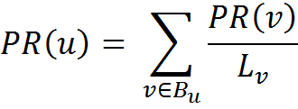
PageRank
PageRank (PR) of page C = PR(A)/2 + PR(B)/1
More generally,
B_{u} is the set of pages that point to u, and
L_{v} is the number of outgoing links from page v (not counting duplicate links)

Slide 8
PageRank
0.5
1
0.5
1
Don’t know PageRank values at start
Assume equal initial PR values (1/3 in this case), then iterate:
first iteration: PR(C) = 0.33/2 + 0.33 = 0.5, PR(A) = 0.33, and PR(B) = 0.17
second: PR(C) = 0.33/2 + 0.17 = 0.33, PR(A) = 0.5, PR(B) = 0.17
third: PR(C) = 0.42, PR(A) = 0.33, PR(B) = 0.25
Converges to PR(C) = 0.4, PR(A) = 0.4, and PR(B) = 0.2

Slide 9
PageRank
Taking random page jump into account, 1/3 chance of going to any page when r < λ
PR(C) = λ/3 + (1 − λ) · (PR(A)/2 + PR(B)/1)
More generally,
where N is the number of pages, λ typically 0.15

Slide 10
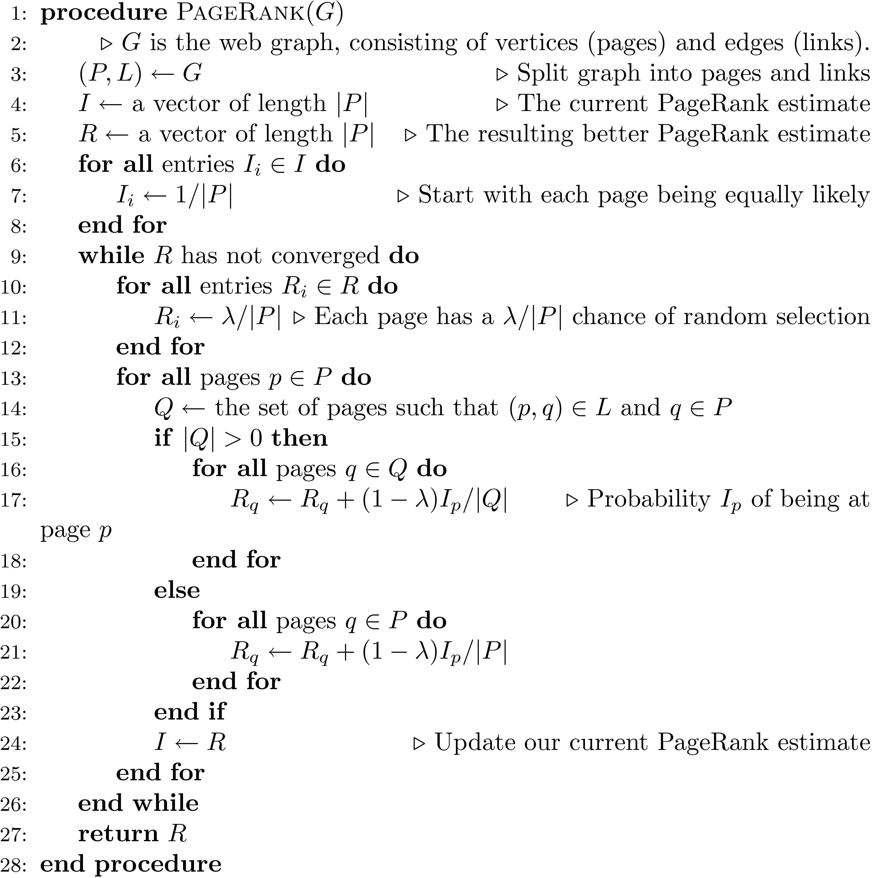

Slide 11
A PageRank Implementation
Preliminaries:
1) Extract links from the source text. You'll also want to extract the URL from each document in a separate file. Now you have all the links (source-destination pairs) and all the source documents
2) Remove all links from the list that do not connect two documents in the corpus. The easiest way to do this is to sort all links by destination, then compare that against the corpus URLs list (also sorted)
3) Create a new file I that contains a (url, pagerank) pair for each URL in the corpus. The initial PageRank value is 1/#D (#D = number of urls)
At this point there are two interesting files:
[L] links (trimmed to contain only corpus links, sorted by source URL)
[I] URL/PageRank pairs, initialized to a constant

Slide 12
A PageRank Implementation
Preliminaries - Link Extraction from .corpus file using Galago
DocumentSplit -> IndexReaderSplitParser -> TagTokenizer
split = new DocumentSplit ( filename, filetype, new byte[0], new byte[0] )
index = new IndexReaderSplitParser ( split )
tokenizer = new.TagTokenizer ( )
tokenizer.setProcessor ( NullProcessor ( Document.class ) )
doc = index.nextDocument ( )
tokenizer.process ( doc )
doc.identifier contains the file’s name
doc.tags now contains all tags
Links can be extracted by finding all tags with name “a”
Links should be processed so that they can be compared with some file name in the corpus

Slide 13
A PageRank Implementation
Iteration:
Steps:
Make a new output file, R.
Read L and I in parallel (since they're all sorted by URL).
For each unique source URL, determine whether it has any outgoing links:
If not, add its current PageRank value to the sum: T (terminals).
If it does have outgoing links, write (source_url, dest_url, Ip/|Q|), where Ip is the current PageRank value, |Q| is the number of outgoing links, and dest_url is a link destination. Do this for all outgoing links. Write this to R.
Sort R by destination URL.
Scan R and I at the same time. The new value of Rp is: (1 - lambda) / #D (a fraction of the sum of all pages) plus: lambda * sum(T) / #D (the total effect from terminal pages), plus: lambda * all incoming mass from step 5. ()
Check for convergence
Write new Rp values to a new I file.

Slide 14
A PageRank Implementation
Convergence check
Stopping criteria for this types of PR algorithm typically is of the form ||new - old|| < tau where new and old are the new and old PageRank vectors, respectively.
Tau is set depending on how much precision you need. Reasonable values include 0.1 or 0.01. If you want really fast, but inaccurate convergence, then you can use something like tau=1.
The setting of tau also depends on N (= number of documents in the collection), since ||new-old|| (for a fixed numerical precision) increases as N increases, so you can alternatively formulate your convergence criteria as ||new – old|| / N < tau.
Either the L1 or L2 norm can be used.

Slide 15
Link Quality
Link quality is affected by spam and other factors
e.g., link farms to increase PageRank
trackback links in blogs can create loops
links from comments section of popular blogs
Blog services modify comment links to contain rel=nofollow attribute
e.g., “Come visit my <a rel=nofollow href="http://www.page.com">web page</a>.”

Slide 16
Trackback Links

Slide 17
Information Extraction
Automatically extract structure from text
annotate document using tags to identify extracted structure
Named entity recognition
identify words that refer to something of interest in a particular application
e.g., people, companies, locations, dates, product names, prices, etc.

Slide 18
Named Entity Recognition
Example showing semantic annotation of text using XML tags
Information extraction also includes document structure and more complex features such as relationships and events

Slide 19
Named Entity Recognition
Rule-based
Uses lexicons (lists of words and phrases) that categorize names
e.g., locations, peoples’ names, organizations, etc.
Rules also used to verify or find new entity names
e.g., “<number> <word> street” for addresses
“<street address>, <city>” or “in <city>” to verify city names
“<street address>, <city>, <state>” to find new cities
“<title> <name>” to find new names

Slide 20
Named Entity Recognition
Rules either developed manually by trial and error or using machine learning techniques
Statistical
uses a probabilistic model of the words in and around an entity
probabilities estimated using training data (manually annotated text)
Hidden Markov Model (HMM) is one approach

Slide 21
HMM for Extraction
Resolve ambiguity in a word using context
e.g., “marathon” is a location or a sporting event, “boston marathon” is a specific sporting event
Model context using a generative model of the sequence of words
Markov property: the next word in a sequence depends only on a small number of the previous words

Slide 22
HMM for Extraction
Markov Model describes a process as a collection of states with transitions between them
each transition has a probability associated with it
next state depends only on current state and transition probabilities
Hidden Markov Model
each state has a set of possible outputs
outputs have probabilities

Slide 23
HMM Sentence Model
Each state is associated with a probability distribution over words (the output)

Slide 24
HMM for Extraction
Could generate sentences with this model
To recognize named entities, find sequence of “labels” that give highest probability for the sentence
only the outputs (words) are visible or observed
states are “hidden”
e.g., <start><name><not-an-entity><location><not-an-entity><end>
Viterbi algorithm used for recognition

Slide 25
Named Entity Recognition
Accurate recognition requires about 1M words of training data (1,500 news stories)
may be more expensive than developing rules for some applications
Both rule-based and statistical can achieve about 90% effectiveness for categories such as names, locations, organizations
others, such as product name, can be much worse

Slide 26
Information Retrieval – the Future
Social search
User tags
Searching with(in) communities
Filtering and recommending
Peer-to-peer and metasearch
Machine learning: clustering, classification, dimensional reduction (LSI)

Slide 27
Beyond Bag–of–words: state of the arts
Feature-based retrieval models / profiling
Term dependence models
Entity search
Social & web people search
Question answering
Machine Translation
Multimedia search
Summarization

Slide 28
Build a simple Search Engine - Lucene
Gunakan koleksi dokumen yang sudah dikumpulkan per kelompok untuk membuat mesin temu balik sederhana
Bacalah tutorial Lucene, misalnya:
http://www.tutorialspoint.com/lucene/index.htm
Lakukan tahapan sbb dengan Lucene:
Pembangunan indeks
Temu balik sederhana
Pemrosesan kueri (term, term range, prefix, Boolean, phrase, wild card) ~ pilih 3 teknik pemrosesan dengan 5 kueri sesuai topik dokumen
Buatlah laporan untuk aplikasi yang berhasil dikembangkan
Lucene: komponen, arsitektur, cara kerja, dll
Implementasi
Analisis hasil (pemrosesan kueri apa yang lebih baik): sebaiknya dengan grafik precision – recall
Demo: Selasa, 26 Januari 2016
Laporan: Kamis, 28 Januari 2016 (saat UAS)

