Slide 1
Retrieval Model (4)
Topic Model
Inference Network Model (Indri)

Slide 2
Exercise (Binary Independence Model)
We have a collection of documents with respectively relevance judgements
D1 = “football cricket” (R)
D2 = “cricket termite grasshopper” (NR)
D3 = “football football team hockey” (R)
D4 = “termite team goal” (R)
D5 = “obama football and hockey team” (NR)
Q= “football cricket hockey termite”
Rank the documents in descending order of their RSV!

Slide 3
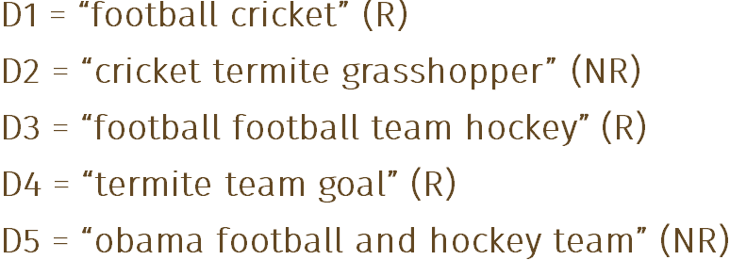
BIM Exercise
a query term | Document | R | NR
Term present | x _{i} = 1 | p_{i} | s_{i}
Term absent | x _{i} = 0 | 1 - p_{i} | 1 - s_{i}
q=“ football cricket hockey team”
football | Document | R | NR
Term present | x _{i} = 1 | 0.67 | 0.5
Term absent | x _{i} = 0 | 0.33 | 0.5
Laplace Smoothing
RSV1 | football cricket | football + cricket | = | 0
RSV2 | cricket termite grasshopper | cricket + termite | = | -0.602
RSV3 | football football team hockey | football + hockey | = | 0
RSV4 | termite team goal | termite | = | -0.301
RSV5 | obama footbal and hockey team | football + hockey | = | 0
cricket | Document | R | NR
Term present | x _{i} = 1 | 0.33 | 0.5
Term absent | x _{i} = 0 | 0.67 | 0.5
hockey | Document | R | NR
Term present | x _{i} = 1 | 0.33 | 0.5
Term absent | x _{i} = 0 | 0.67 | 0.5
team | Document | R | NR
Term present | x _{i} = 1 | 0.67 | 0.5
Term absent | x _{i} = 0 | 0.33 | 0.5

Slide 4
Mixture LM: Example and exercise (1)
Document collection (2 documents)
d₁: Xerox reports a profit but revenue is down
d₂: Lucent narrows quarter loss but revenue decreases further
Model: MLE unigram from documents; λ = ½
Query: revenue down
P(Q|d₁) = [(1/8 + 2/16)/2] x [(1/8 + 1/16)/2]
= 1/8 x 3/32 = 3/256
P(Q|d₂) = [(1/8 + 2/16)/2] x [(0 + 1/16)/2]
= 1/8 x 1/32 = 1/256
Ranking: d₁ > d₂
Proof this

Slide 5
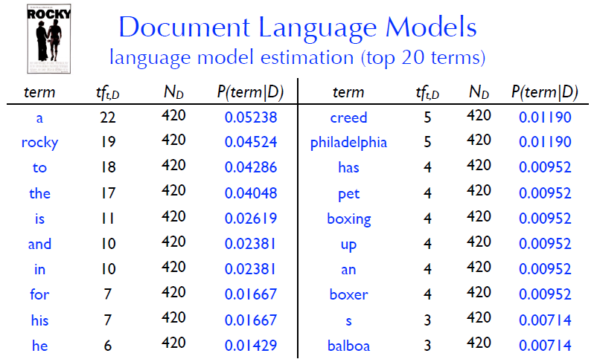
Exercise LM (2)

Slide 6
Topic Models
We can think of a topic as being defined by a language model
A high-probability of seeing certain words and a low probability of seeing others

Slide 7
Topical Relevance
Many factors affect whether a document satisfies a particular user’s information need
Topicality, novelty, freshness, authority, formatting, reading level, assumed level of expertise, etc.
Topical relevance: the document is on the same topic as the query
User relevance: everything else!
Remember, our goal right now is to predict topical relevance

Slide 8
Document Language Models (1)
The topic (or topics) discussed in a particular document can be captured by its language model

Slide 9
Document Language Models (2)
Assume that a document has the same multinomial factor for all document topics
Movies = (0.25 * 0.50) * (0.50 * 0.50) = 0.03125
Politics = (0.95 * 0.50) * (0.05 * 0.50) = 0.011875
Sports = (0.00 * 0.50) * (0.90 * 0.50) = 0.45
Music = (0.50 * 0.50) * (0.00 * 0.50) = 0.25
Nature = (0.10 * 0.50) * (0.10 * 0.50) = 0.0025
∏P(t|D).P(t|LM)

Slide 10
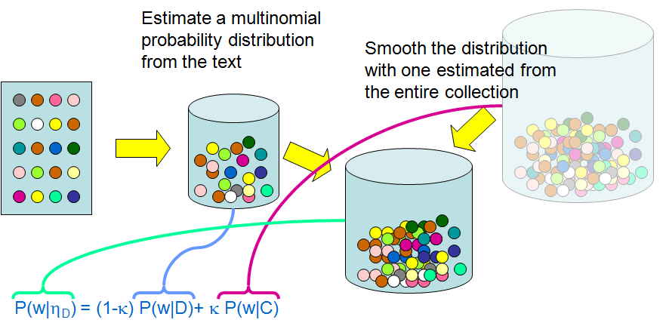
Inference Model based on Language Model

Slide 11
Query Likelihood
Estimate probability that document generated the query terms

Slide 12
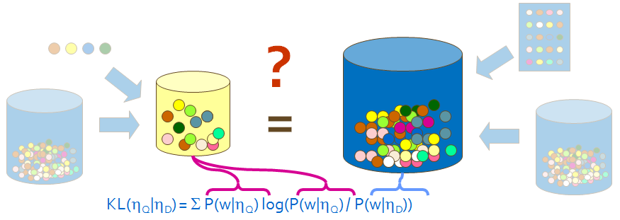
Kullback-Leibler Divergence
Estimate models for document and query and compare

Slide 13
Inference Networks (1)
Language models used to estimate beliefs of representation nodes

Slide 14
Inference Networks (2)
Document node (D) corresponds to the event that a document is observed
Representation nodes (r_{i}) are document features (evidence)
Probabilities associated with those features are based on language models θ estimated using the parameters μ
one language model for each significant document structure
r_{i} nodes can represent proximity features, or other types of evidence (e.g. date)

Slide 15
Inference Networks (3)
Query nodes (q_{i}) are used to combine evidence from representation nodes and other query nodes
represent the occurrence of more complex evidence and document features
a number of combination operators are available
Information need node (I) is a special query node that combines all of the evidence from the other query nodes
network computes P(I|D, μ)

Slide 16
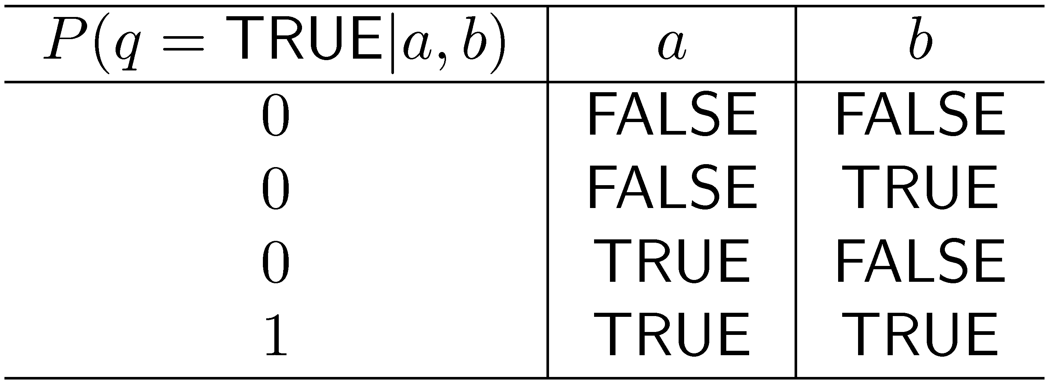
Example: AND Combination
a and b are parent nodes for q

Slide 17
Example: AND Combination
Combination must consider all possible states of parents
Some combinations can be computed efficiently

Slide 18
Inference Network Operators

Slide 19
Indri: Summary of Ranking
http://www.lemurproject.org/
Techniques use simple multinomial probability distributions to model vocabulary usage
The distributions are smoothed with a collection model to prevent zero probabilities
This has an idf-like effect on ranking
Documents are ranked through generative or distribution similarity measures
Inference networks allow structured queries – beliefs estimated are related to generative probabilities

Slide 20
Other Techniques
(Pseudo-) Relevance Feedback
Relevance Models [Lavrenko 2001]
Markov Chains [Lafferty and Zhai 2001]
n-Grams [Song and Croft 1999]
Term Dependencies

Slide 21
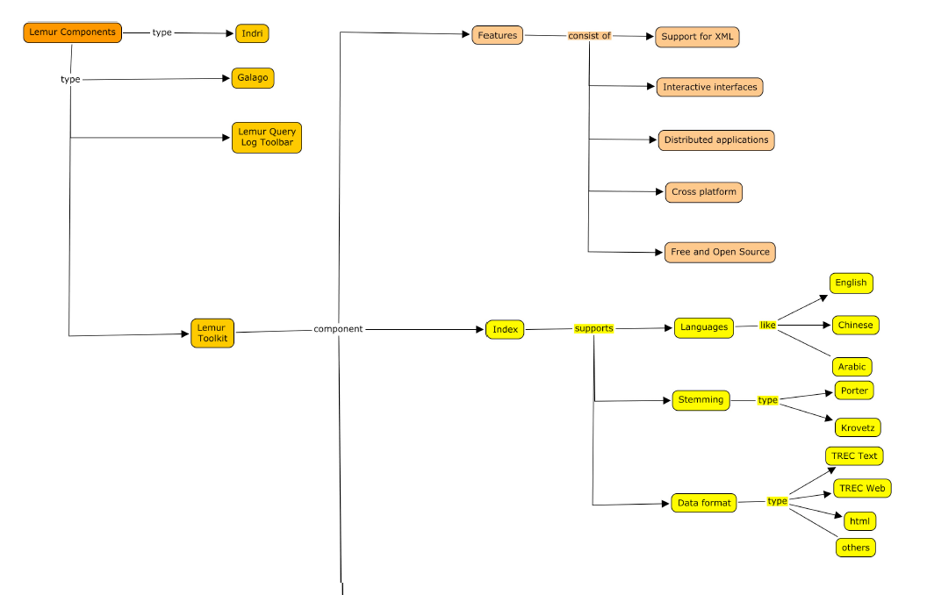
Indri Overview
http://www.cs.cmu.edu/~lemur/LemurGuide.html

Slide 22
Indri Overview: Retrieval

Slide 23
GUI Indri Index Builder

Slide 24
GUI Indri Retrieval

Slide 25
Two Index Formats
KeyFile
Term Positions
Metadata
Offline Incremental
InQuery Query Language
Indri
Term Positions
Metadata
Fields / Annotations
Online Incremental
InQuery and Indri Query Languages
Notes:
Blue text indicates settings specific to Indri applications. Refer to online documentation for other Lemur application parameters.

Slide 26
Indexing – Document Preparation
Document Formats:
The Lemur Toolkit can inherently deal with several different document format types without any modification:
TREC Text
TREC Web
Plain Text
Microsoft Word^{(*)}
Microsoft PowerPoint^{(*)}
HTML
XML
PDF
Mbox
(*) Note: Microsoft Word and Microsoft PowerPoint can only be indexed on a Windows-based machine, and Office must be installed.

Slide 27
Indexing – Document Preparation
If your documents are not in a format that the Lemur Toolkit can inherently process:
If necessary, extract the text from the document.
Wrap the plaintext in TREC-style wrappers:
<DOC>
<DOCNO>document_id</DOCNO>
<TEXT>
Index this document text.
</TEXT>
</DOC>
– or –
For more advanced users, write your own parser to extend the Lemur Toolkit.
Notes:
Could also work with plain text documents

Slide 28
Indexing - Parameters
Basic usage to build index:
IndriBuildIndex <parameter_file>
Parameter file includes options for
Where to find your data files
Where to place the index
How much memory to use
Stopword, stemming, fields
Many other parameters.

Slide 29
Indexing – Parameters
Standard parameter file specification an XML document:
<parameters>
<option></option>
<option></option>
…
<option></option>
</parameters>

Slide 30
Retrieval
Parameters
Query Formatting
Interpreting Results

Slide 31
Retrieval - Parameters
Basic usage for retrieval:
IndriRunQuery/RetEval <parameter_file>
Parameter file includes options for
Where to find the index
The query or queries
How much memory to use
Formatting options
Many other parameters.

Slide 32
Retrieval - Parameters
Just as with indexing:
A well-formed XML document with options, wrapped by <parameters> tags:
<parameters>
<options></options>
<options></options>
…
<options></options>
</parameters>

Slide 33
Retrieval – Interpreting Results
The default output from IndriRunQuery will return a list of results, 1 result per line, with 4 columns:
<score>: the score of the returned document. An Indri query will always return a negative value for a result.
<docID>: the document ID
<extent_begin>: the starting token number of the extent that was retrieved
<extent_end>: the ending token number of the extent that was retrieved

Slide 34
Retrieval – Interpreting Results
When executing IndriRunQuery with the default formatting options, the output will look something like:
<score> <DocID> <extent_begin> <extent_end>
-4.83646 AP890101-0001 0 485
-7.06236 AP890101-0015 0 385

Slide 35
Indri Query Language
terms
field restriction / evaluation
numeric
combining beliefs
field / passage retrieval
filters
document priors
http://www.lemurproject.org/lemur/IndriQueryLanguage.html

Slide 36
Term Operations
name | example | behavior
term | dog | occurrences of dog (Indri will stem and stop)
“term” | “dog” | occurrences of dog (Indri will not stem or stop)
ordered window | #odn(blue car) | blue n words or less before car
unordered window | #udn(blue car) | blue within n words of car
synonym list | #syn(car automobile) | occurrences of car or automobile
weighted synonym | #wsyn(1.0 car 0.5 automobile) | like synonym, but only counts occurrences of automobile as 0.5 of an occurrence
any operator | #any:person | all occurrences of the person field

Slide 37
Field Restriction/Evaluation
name | example | behavior
restriction | dog.title | counts only occurrences of dog in title field
 | dog.title,header | counts occurrences of dog in title or header
evaluation | dog.(title) | builds belief b(dog) using title language model
 | dog.(title,header) | b(dog) estimated using language model from concatenation of all title and header fields
#od1(trevor strohman).person(title) |  | builds a model from all title text for b(#od1(trevor strohman).person) - only counts “trevor strohman” occurrences in person fields

Slide 38
Numeric Operators
name | example | behavior
less | #less(year 2000) | occurrences of year field < 2000
greater | #greater(year 2000) | year field > 2000
between | #between(year 1990 2000) | 1990 < year field < 2000
equals | #equals(year 2000) | year field = 2000

Slide 39
Belief Operations
name | example | behavior
combine | #combine(dog train) | 0.5 log( b(dog) ) + 0.5 log( b(train) )
weight, wand | #weight(1.0 dog 0.5 train) | 0.67 log( b(dog) ) + 0.33 log( b(train) )
wsum | #wsum(1.0 dog 0.5 dog.(title)) | log( 0.67 b(dog) + 0.33 b(dog.(title)) )
not | #not(dog) | log( 1 - b(dog) )
max | #max(dog train) | returns maximum of b(dog) and b(train)
or | #or(dog cat) | log(1 - (1 - b(dog)) * (1 - b(cat)))
Notes:
Indri normalizes weights to sum to 1.

Slide 40
Field/Passage Retrieval
name | example | behavior
field retrieval | #combine[title]( query ) | return only title fields ranked according to #combine(query) - beliefs are estimated on each title’s language model -may use any belief node
passage retrieval | #combine[passage200:100]( query ) | dynamically created passages of length 200 created every 100 words are ranked by #combine(query)

Slide 41
More Field/Passage Retrieval
example | behavior
#combine[section]( bootstrap #combine[./title]( methodology )) | Rank sections matching bootstrap where the section’s title also matches methodology
.//field for ancestor
.\field for parent
Notes:
Better example and mention filed hierarchy at index time

Slide 42
Filter Operations
name | example | behavior
filter require | #filreq(elvis #combine(blue shoes)) | rank documents that contain elvis by #combine(blue shoes)
filter reject | #filrej(shopping #combine(blue shoes)) | rank documents that do not contain shopping by #combine(blue shoes)

Slide 43
Document Priors
name | example | behavior
prior | #combine(#prior(RECENT) global warming) | treated as any belief during ranking RECENT prior could give higher scores to more recent documents
RECENT prior built using makeprior application

Slide 44
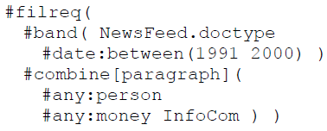
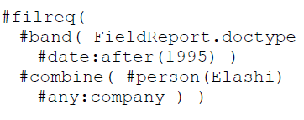
Contoh lain INQUERY

Slide 45
each term occurs once for each class
KUIS 5

Slide 46
Smoothing
Document texts are a sample from the language model
Missing words should not have zero probability of occurring
Smoothing is a technique for estimating probabilities for missing (or unseen) words
lower (or discount) the probability estimates for words that are seen in the document text
assign that “left-over” probability to the estimates for the words that are not seen in the text

