Slide 1
Chapter 8: Moving on to Design
22 Oktober 2015:
UTS
System Design
Project Proposal

Slide 2
UTS – Use Case

Slide 3
UTS – Class Diagram

Slide 4
UTS – Sequence Diagram

Slide 5
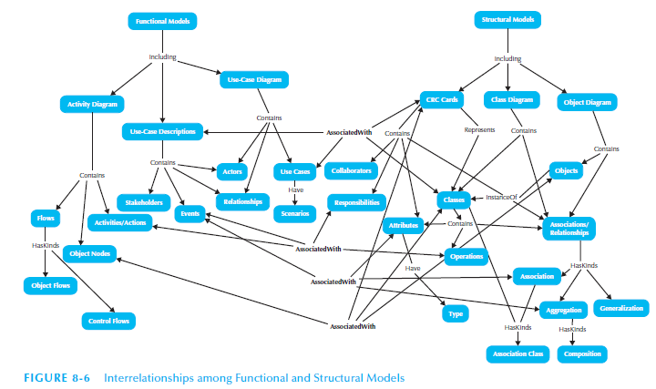

Slide 6
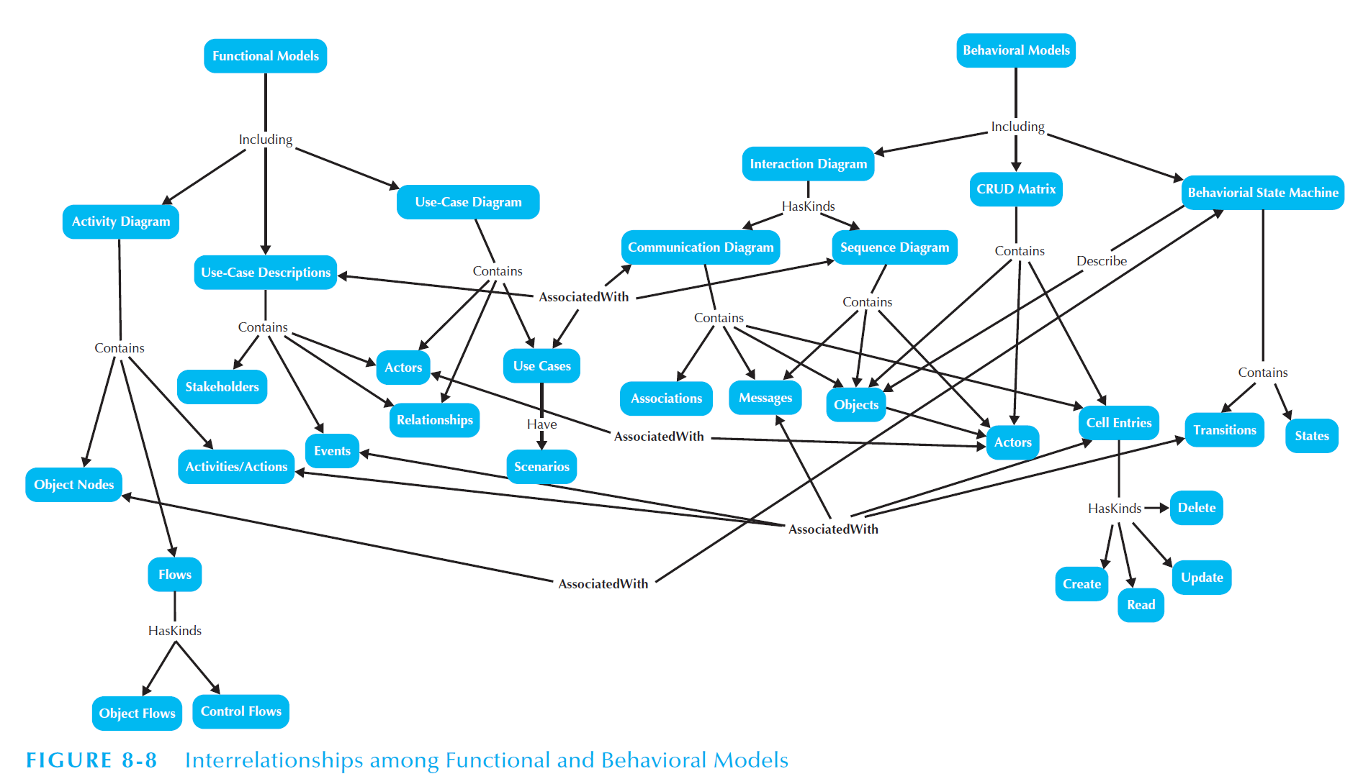

Slide 7
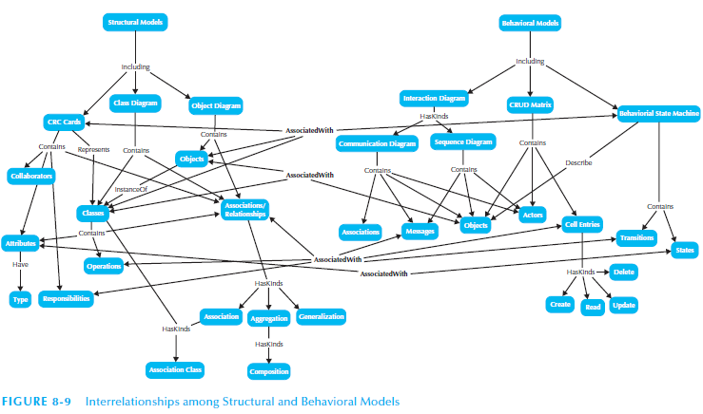

Slide 8
System Design
Decisions about how to build a system
Create a blueprint for the “To Be” system
HW, SW, & Architecture decisions are made
User Interface & system input/output decisions are made

Slide 9
Evolving Analysis Models into Design Models
Factoring – creating a superior (parent) class so that attributes may be shared & reused
Abstraction & Refinement – creating subclasses (child classes) to share attributes
Partitioning & Collaboration – decomposing a larger system into subset systems

Slide 10
Layers
Layer – element of the software architecture of the evolving system (5 layers):
Foundation – outlines classes that comprise system
System Architecture – communication among system components
Human-Computer Interaction – how users interact with system
Data Management – how classes are stored, related, & retrieved
Problem Domain – how classes meet business problem & system specifications

Slide 11
Layers and Sample Classes
Information System Resources:
People
Hardware
Software
Procedures
Data

Slide 12
Package
GUI
Package – Group of Classes based on Layers
Package Diagram – Diagram of only Packages
Can used to group Classes together by Layer
Requirements
System Connections
Physical Architecture
File interfaces
Data structures

Slide 13
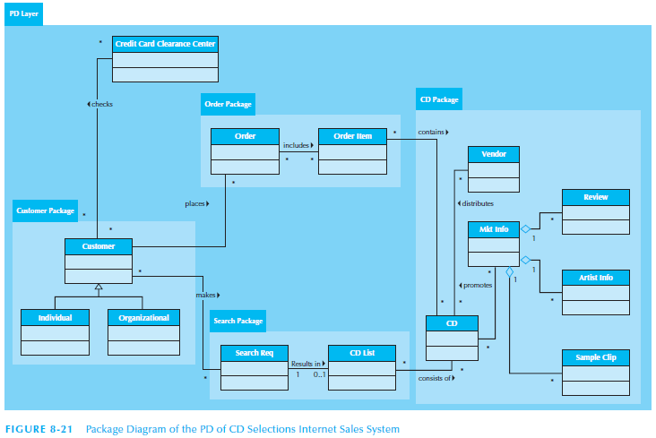
Package Diagram Example

Slide 14
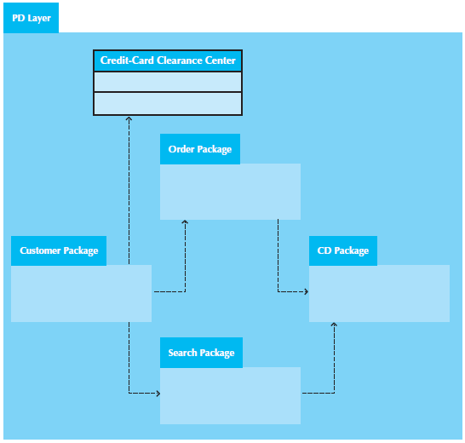
Package Diagram Example

Slide 15
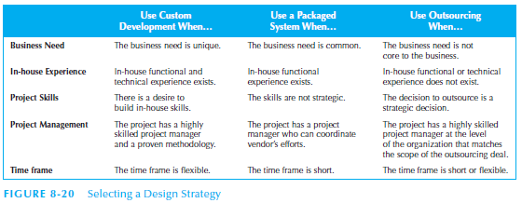
Design Strategies
Three Strategies:
Custom Development
Packaged Software
Outsourcing

Slide 16
Alternative Matrix

Slide 17
Proposals Discussion
Scope of project
Requirements
Use case diagram: include, extends, optional
(Activity diagram - when needed)
Class diagram: association, generalization, abstract class, aggregation, composition, properties, operation, multiplicity
Sequence diagram: life line, message
Technical alternatives

