Slide 1
28 Oct 2015: Chp. 7 Moving Beyond Linearity
Quiz Chp. 6
Polynomial Regression
Step Functions
Basis Functions
Regression Splines
Smoothing Splines
Local Regression
Generalized AdditiveModels

Slide 2
Kuis
Apakah akibat dari perbedaan jumlah n (=records) dan p (=attributes), untuk regresi linear sebagai berikut:
n >> p
n ~ p
n << p
Berikan konseptual dan cara kerja untuk metode-metode:
Subset selection
Shrinkage
Dimensional reduction
Apakah perbedaan mendasar antara best subset selection dan forward/backward selection? Apakah keuntungan dan kerugian dari masing-masing?
Apakah perbedaan mendasar antara regresi linear konvensional dengan metode shrinkage, seperti ridge regression dan lasso?
Berikan konsep dasar metode PCA (Principal Component Analysis). Berikan contoh dan penjelasan.

Slide 3
Moving Beyond Linearity

Slide 4
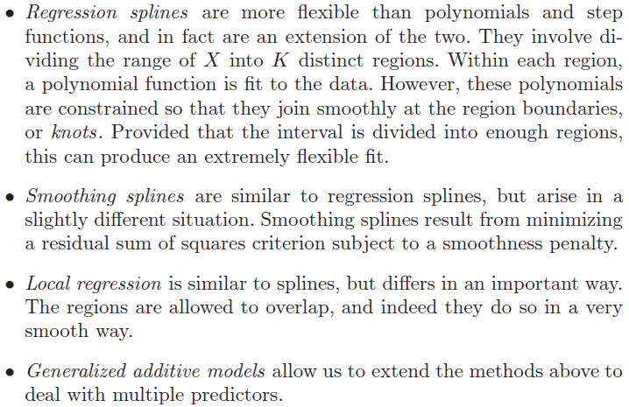

Slide 5
Polynomial Regression

Slide 6
Detail Polynomial Regression

Slide 7
Detail Polynomial Regression (cont’d)

Slide 8
Step Functions

Slide 9
Step Functions (Cont’d)

Slide 10
Fitting Step Functions

Slide 11
Piecewise Polynomials

Slide 12
Piecewise Polynomials (cont’d)

Slide 13
Linear Splines

Slide 14
Linear Splines (cont’d)

Slide 15
Cubic Splines

Slide 16
Cubic Splines (cont’d)

Slide 17
Natural Cubic Splines

Slide 18
Fitting splines in R

Slide 19
Knot Replacement

Slide 20
Smoothing splines

Slide 21
Smoothing splines (cont’d)

Slide 22
Smoothing Splines (con’d) – choosing λ

Slide 23
Smoothing splines

Slide 24
Local Regression

Slide 25
Local Regression Algorithm

Slide 26
Generalized Additive Models

Slide 27
GAM Details

Slide 28
GAM for Classification

Slide 29
Practical Exercise (Chp. 7 ISLR)
Lab 1: Polynomial Regression and Step Functions
Lab 2: Splines
Lab 3: GAMs

Slide 30
Tugas Besar
Progress??

