Slide 1
21 Oct 2015: Chp. 6 Linear Model Selection and Regularization
Feature (Subset) Selection
Shrinkage
Intro to Dimensionality Reduction

Slide 2
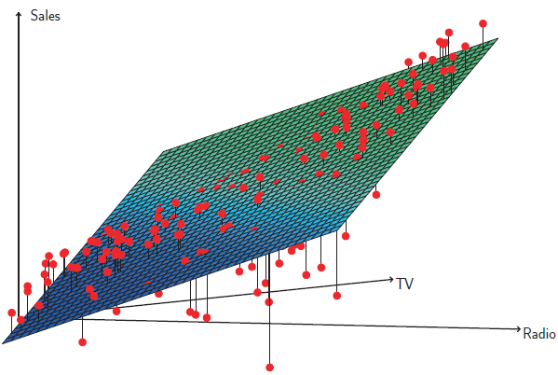
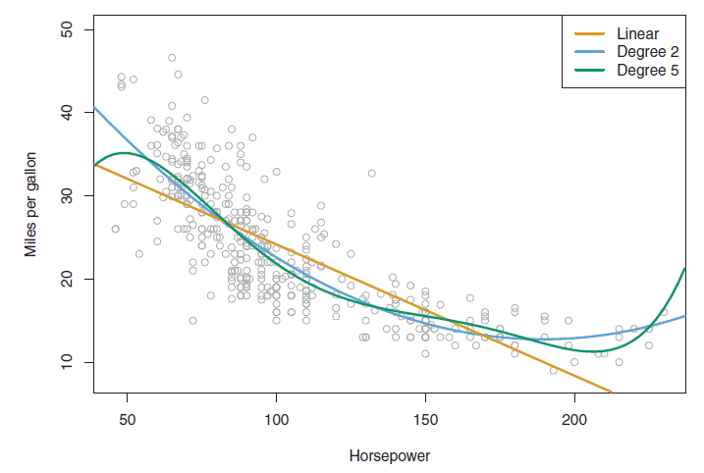
In Praise of Linear Model
Despite its simplicity, the linear model has distinct advantages in terms of its interpretability and often shows good predictive performance.

Slide 3
Prediction Accuracy
If n >> p—that is, if n, the number of observations, is much larger than p, the number of variables—then the least squares estimates tend to also have low variance, and hence will perform well on test observations.
However, if n is not much larger than p, then there can be a lot of variability in the least squares fit, resulting in overfitting and consequently poor predictions on future observations not used in model training.
And if p >> n, then there is no longer a unique least squares coefficient estimate: the variance is infinite so the method cannot be used at all.

Slide 4
Model Interpretability
By removing irrelevant features, that is, by setting the corresponding coeficient estimates to zero we can obtain a model that is more easily interpreted. We will present some approaches for automatically performing feature selection.

Slide 5
Using least squares to fit

Slide 6
Subset Selection - Best Subset Selection

Slide 7
Subset Selection - Best Subset Selection Credit data example
The number of possible models that must be considered grows rapidly as p increases. In general, there are 2p models that involve subsets of p predictors.
So if p = 10, then there are approximately 1,000 possible models to be considered, and if p = 20, then there are over one million possibilities!
Thus an enormous search space can lead to overfitting and high variance of the coecient estimates.
Stepwise methods, which explore a far more restricted set of models, are attractive alternatives to best subset selection.

Slide 8
Forward Stepwise Selection

Slide 9
Forward Stepwise – Credit data example

Slide 10
Backward Stepwise Selection

Slide 11
Choosing the optimal model

Slide 12
Cp, AIC, BIC & Adjusted R²
Mallow’s Cp
AIC (Akaike Information Criteria)
BIC (Bayes Information Criteria)
Adjusted R²

Slide 13
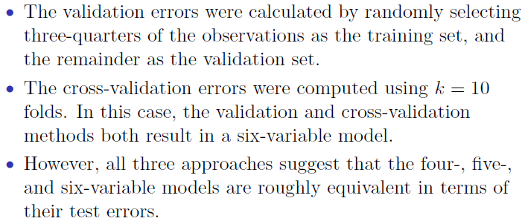
Cp, AIC, BIC & Adjusted R² – Credit data example

Slide 14
Validation and Cross-Validation

Slide 15
Shrinkage Methods

Slide 16
Ridge Regression

Slide 17
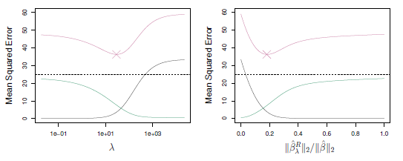
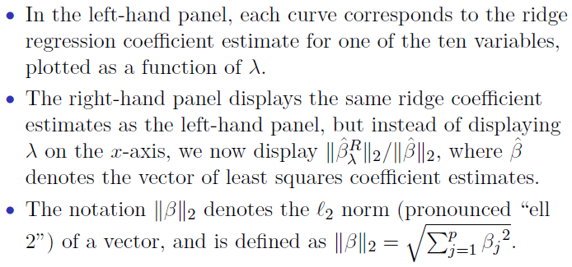
Ridge Regression - Credit data example

Slide 18
The Lasso

Slide 19
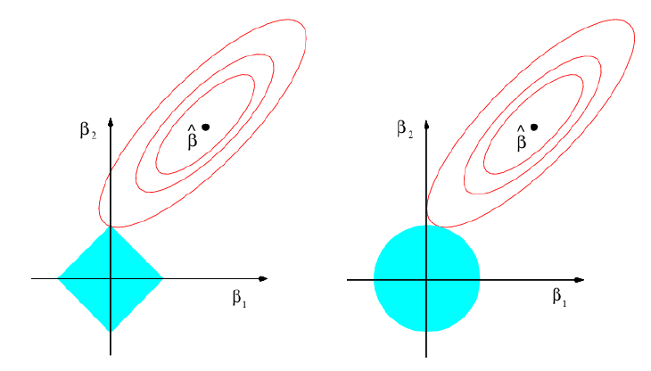
The Lasso - Credit data example

Slide 20
Dimension Reduction Methods

Slide 21
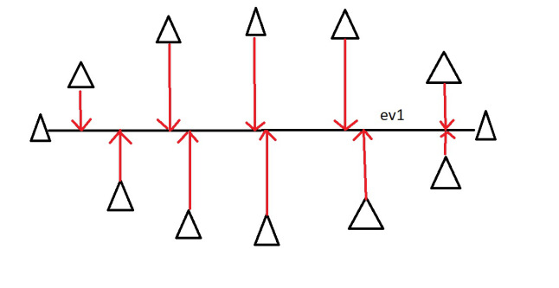
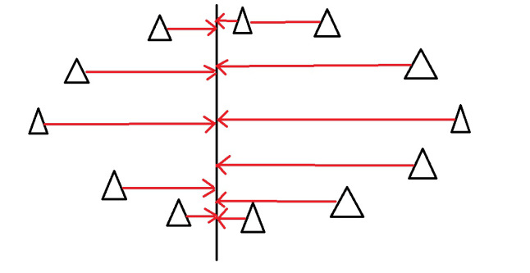
PCA Idea (1)

Slide 22
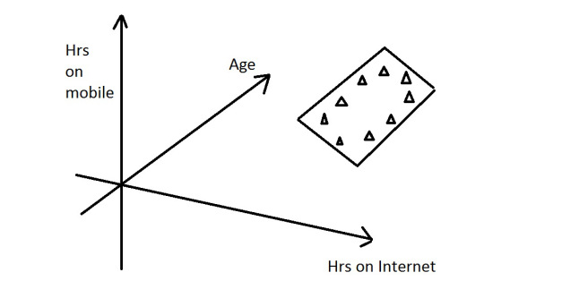
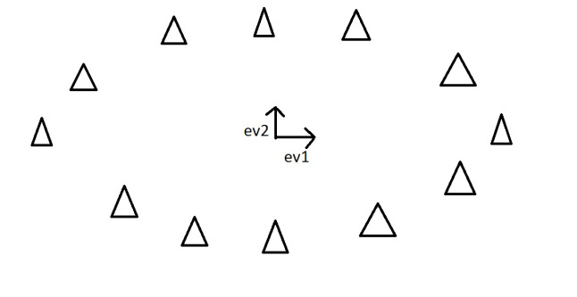
PCA Idea (2)
This is dimension reduction.
We have reduced the problem from a 3D to a 2D problem, getting rid of a dimension.
Reducing dimensions helps to simplify the data and makes it easier to visualise.

Slide 23
Principal Component Regression

Slide 24
PCR vs. Shrinkage

Slide 25
PCR Coefficients Estimation

Slide 26
Exercise
Chapter 6: Exercise 1
a
Best subset selection has the smallest training RSS because the other two methods determine models with a path dependency on which predictors they pick first as they iterate to the k'th model.
b (*)
Best subset selection may have the smallest test RSS because it considers more models then the other methods. However, the other models might have better luck picking a model that fits the test data better.
c
i. True. ii. True. iii. False. iv. False. v. False.

Slide 27
Practical (Chp. 6 ISLR)
Lab 1: Subset Selection Methods
Lab 2: Ridge Regression and the Lasso
Lab 3: PCR

