Slide 1
4- Classification: Logistic Regression
9 September 2015
Intro to Logistic Regression

Slide 2
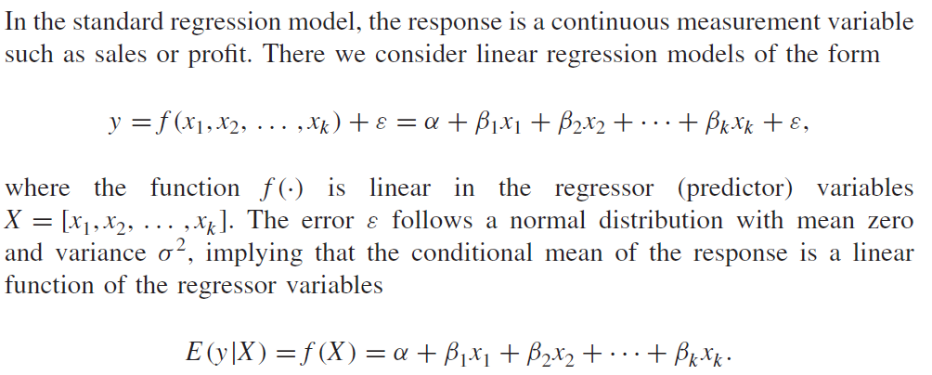
From linear to logistic regression

Slide 3
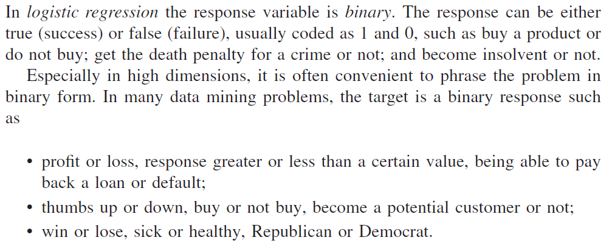
Introduction to Logistic Regression

Slide 4
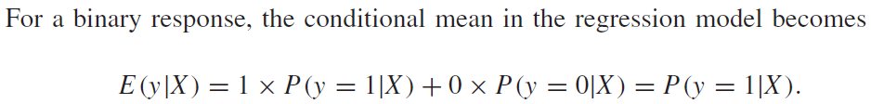
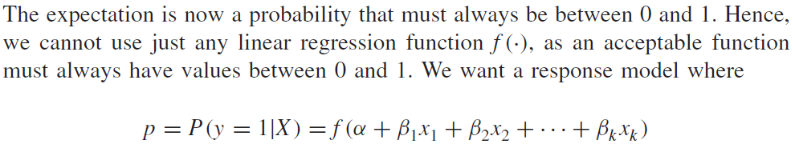

BUILDING A LINEAR MODEL FOR BINARY RESPONSE DATA

Slide 5
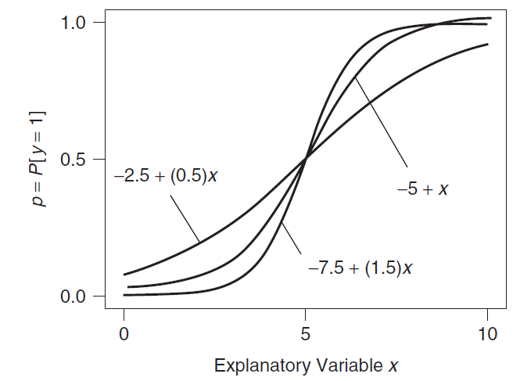
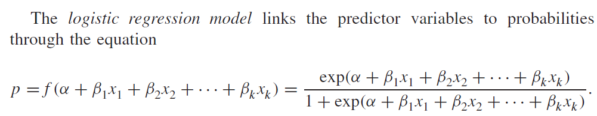
The LOGISTIC MODEL

Slide 6
Logistic Regression Approach
Learning
Transform initial input probabilities into log odds (logit)
Do a standard linear regression on the logit values
  This effectively fits a logistic curve to the data, while still just doing a linear regression with the transformed input (ala quadric machine, etc.)
Generalization
Find the value for the new input on the logit line
Transform that logit value back into a probability

Slide 7
Logistic Regression Approach
Could use linear regression with the probability points, but that would not extrapolate well
Logistic version is better but how do we get it?
We do a non-linear pre-process of the input and then do linear regression on the transformed values – do a linear regression on the log odds
1
1
prob.
Cured
prob.
Cured
0
0
0 10 20 30 40 50 60
0 10 20 30 40 50 60

Slide 8
Non-Linear Pre-Process to Logit (Log Odds)
Dosage | Cured
20 | yes
20 | no
20 | no
20 | no
20 | no
30 | yes
30 | yes
30 | no
30 | no
30 | no
30 | no
40 | yes
40 | yes
40 | yes
40 | yes
40 | no
40 | no
50 | yes
50 | yes
50 | yes
50 | yes
50 | yes
50 | yes
50 | no
Medication Dosage | #Cured | Total Patients | Probability: # Cured/Total Patients
20 | 1 | 5 | 0.20
30 | 2 | 6 | 0.33
40 | 4 | 6 | 0.67
50 | 6 | 7 | 0.86
Notes:
If just 1/0 we would divide at about 35
Go to next slide after probability column and then come back

Slide 9
Non-Linear Pre-Process to Logit (Log Odds)
Medication Dosage | # Cured | Total Patients | Probability: # Cured/Total Patients | Odds: p/(1-p) = # cured/ # not cured | Logit: ln(Odds)
20 | 1 | 5 | 0.20 | 0.25 | -1.39
30 | 2 | 6 | 0.33 | 0.50 | -0.69
40 | 4 | 6 | 0.67 | 2.0 | 0.69
50 | 6 | 7 | 0.86 | 6.0 | 1.79
Cured
1
prob.
Cured
Not Cured
0
0 10 20 30 40 50
0 10 20 30 40 50
Notes:
explain odds with the 40 dosage – ration of wins/losses
mid sigmoid runs through .5 prob = 0 logit = ln(1)

Slide 10
Regression of Log Odds
+2
Medication Dosage | # Cured | Total Patients | Probability: # Cured/Total Patients | Odds: p/(1-p) = # cured/ # not cured | Log Odds: ln(Odds)
20 | 1 | 5 | 0.20 | 0.25 | -1.39
30 | 2 | 6 | 0.33 | 0.50 | -0.69
40 | 4 | 6 | 0.67 | 2.0 | 0.69
50 | 6 | 7 | 0.86 | 6.0 | 1.79
0
-2
0 10 20 30 40 50 60
1
prob.
Cured
0
0 10 20 30 40 50 60
y = .11x – 3.8 - Logit (linear)regression equation
Now we have a regression line for log odds (logit)
To generalize, we interpolate the log odds value for the new data point
Then we transform that log odds point to a probability:
p = e^{logit(x)}/(1+e^{logit(x)}) = 1/(1+e^{-logit(x)})
For example assume we want p for dosage = 10
Logit(10) = .11(10) – 3.8 = -2.7 → p(10) = e^{-2.7}/(1+e^{-2.7}) = 0.06
[note that we just work backwards from logit to p]
These p values make up the sigmoidal regression curve
Notes:
yellow point is a generalization example

Slide 11
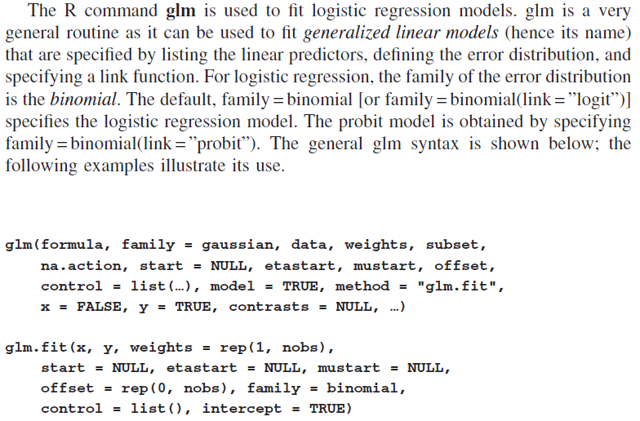
ESTIMATION IN R

Slide 12
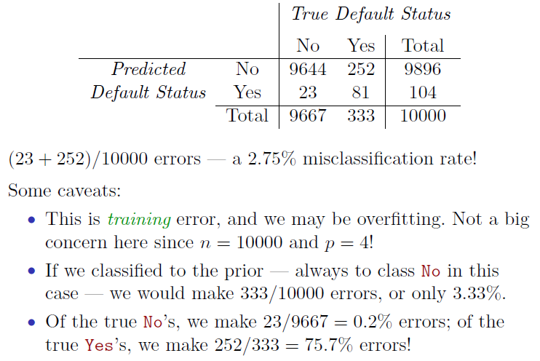
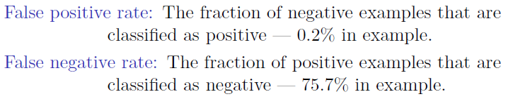
Error Rate

Slide 13
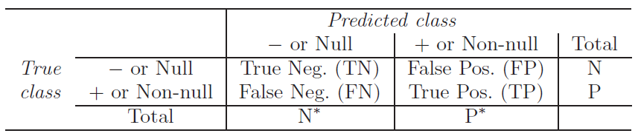
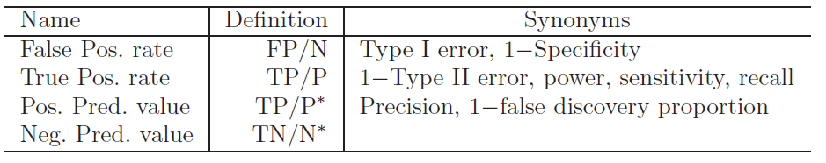
Error Type Generalization

Slide 14
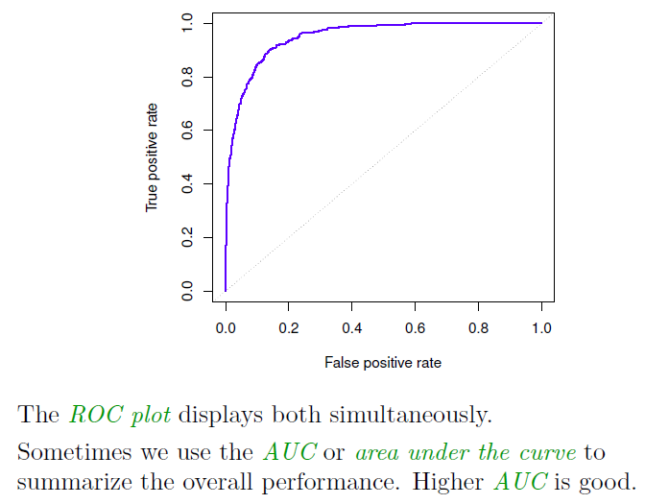
ROC Curve receiver operating characteristics

Slide 15
Kuis3-College.csv
Ikuti langkah (a), (b), (c) dalam ISLR chp. 2 exercise 8.
Buat sebuah variabel college2, yang berisi kopian data dari college.
Gunakan fungsi cor() untuk melihat kaitan antar semua atribut numerik dalam dataset tsb
  Atribut apa sajakah yang memiliki korelasi kuat dengan atribut ‘Apps’ dan ‘PhD’. Berikan alasan.
  Apakah kedua atribut tersebut saling mempengaruhi? Berikan alasan.
Gunakan regresi linear untuk menebak bagaimana ‘Apps’ mempengaruhi ‘PhD’. Berikan komentar.
Analisis dengan menggunakan regresi linear dan plot():
  Kaitan antara ‘Outstate’ dan ‘Grad.Rate’
  Kaitan antara ‘Accept’ dan ‘S.F.Ratio’
  Kaitan antara ‘Top10perc’ dan ‘Grad.Rate’

Slide 16
Tugas2: Aplikasi dengan R-API & Logistic Regression
(Kumpul 23 September 2015)
Buatlah rancangan fungsionalitas dan tampilan untuk aplikasi Anda, bisa dimulai dengan:
  Analisis data : summary, tipe data
  Regresi linear : kaitan antar atribut, probabilitas dan interval keyakinan
  Regresi logistik: prediksi kelas
Contohkan bagaimana R dapat digunakan dari aplikasi yang dikembangkan dengan bahasa pemrograman tingkat tinggi, seperti Java/C#
  Bagaimana koneksi dilakukan?
  Bagaimana fungsi R dipanggil?
  Bagaimana hasil ditampilkan?

Slide 17
Tugas2
Pasien | Emosi | Terapi | Serangan
1 | 70 | 1 | 1
2 | 80 | 1 | 1
3 | 50 | 1 | 1
4 | 60 | 0 | 1
5 | 40 | 0 | 1
6 | 65 | 0 | 1
7 | 75 | 0 | 1
8 | 80 | 0 | 1
9 | 70 | 0 | 1
10 | 60 | 0 | 1
11 | 65 | 1 | 0
12 | 50 | 1 | 0
13 | 45 | 1 | 0
14 | 35 | 1 | 0
15 | 40 | 1 | 0
16 | 50 | 1 | 0
17 | 55 | 0 | 0
18 | 45 | 0 | 0
19 | 50 | 0 | 0
20 | 60 | 0 | 0
Buat tabel logit terhadap atribut Terapi.
Bentuklah regresi linear dari hasil logit tersebut. Tuliskan persamaan linear yang dihasilkan!
Bentuklah model logistik dengan data. Apakah persamaan logit yang dihasilkan bersesuaian dengan nomor 2?
Model linear atau logistik-kah yang lebih baik, mengapa? Berikan contoh!
Berapakah nilai Odds Ratio yang terbentuk untuk atribut Terapi tersebut? Menurut Anda, apakah arti (bukan definisinya, lho!) dari Odds Ratio yang terbentuk tersebut terhadap data?
Coba dengan menyertakan atribut Emosi. Bagaimanakah efeknya terhadap model yang dihasilkan? Apakah memiliki akurasi yang lebih baik dibanding no. 3? Mengapa?

Slide 18
Logistic Regression Practical Work
4.6.1 The Stock Market Data
4.6.2 Logistic Regression
  Model glm()
  Held out train-test
  Confusion matrix

