Slide 1
18 November 2015
Tree-Based Methods Quiz-Review
SVM
Practical Group Assignment
Practical SVM

Slide 2
From Previous Session:
Practical Works
8.3.1 Fitting Classification Trees
8.3.2 Fitting Regression Trees
8.3.3 Bagging and Random Forests
8.3.4 Boosting

Slide 3
Quiz Tree Method
What is the difference between a regression and classification tree?
How does an ensamble method work?
Explain in your own word, what is the main objectives of the following methods:
  Bagging
  Boosting
  Random forests
In your opinion what is the main advantage and dis-advantage of tree methods?
See the next classification tree, and explain what the tree does.

Slide 4
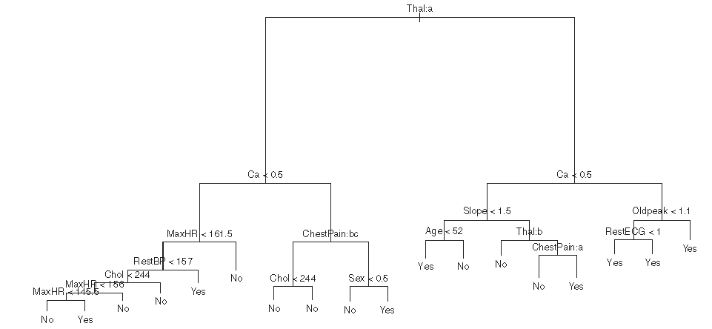

Slide 5
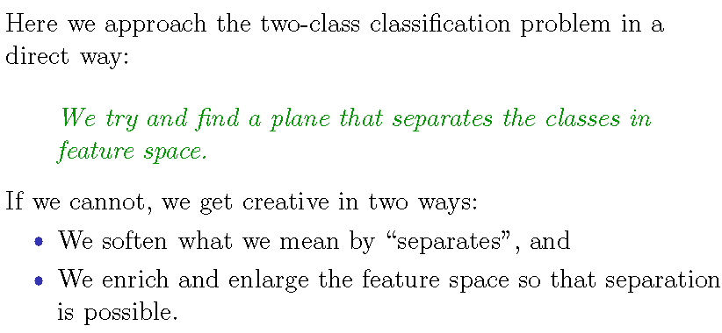
Support Vector Machines

Slide 6
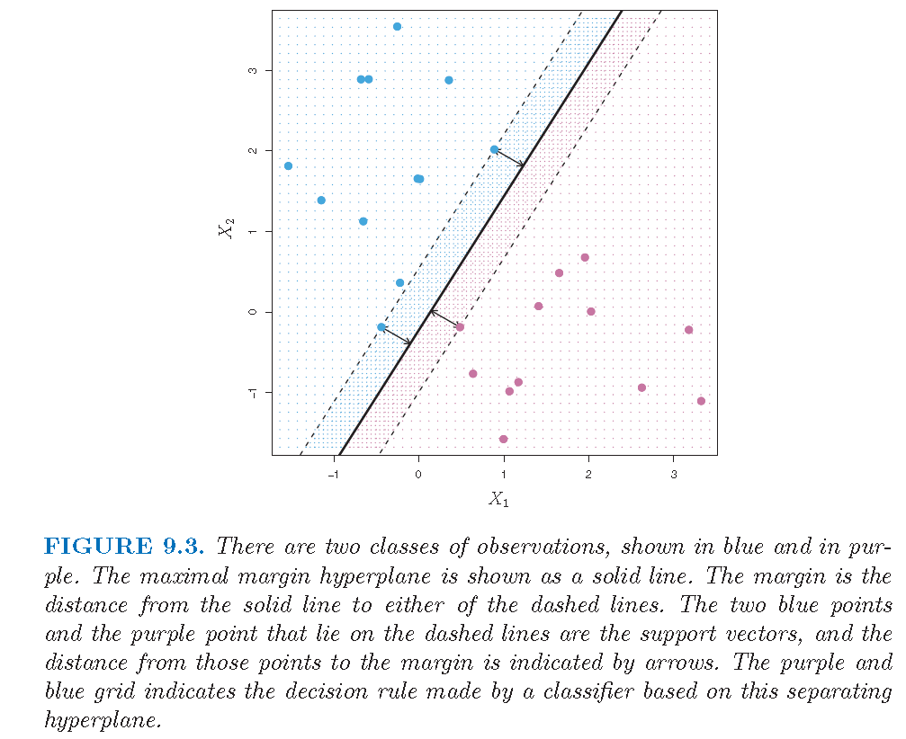
Separating Hyperplane

Slide 7
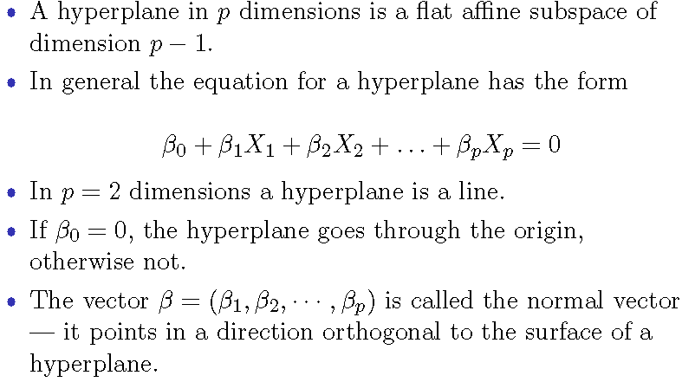
What is a hyperplane?

Slide 8
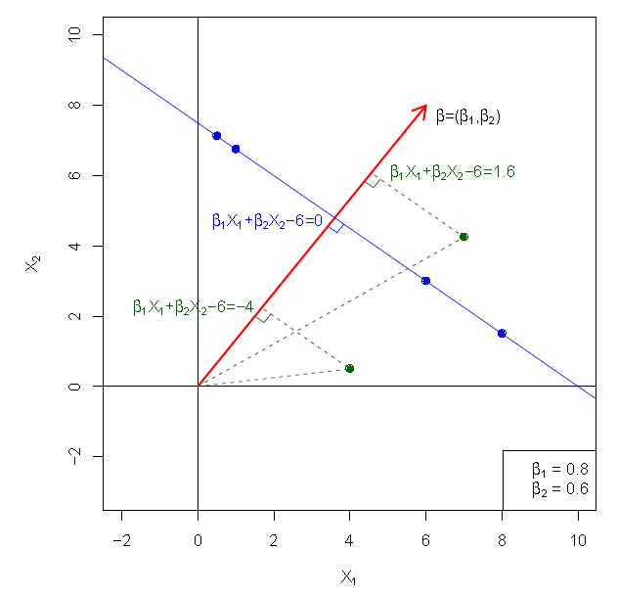
Hyperplane in 2 Dimensions

Slide 9
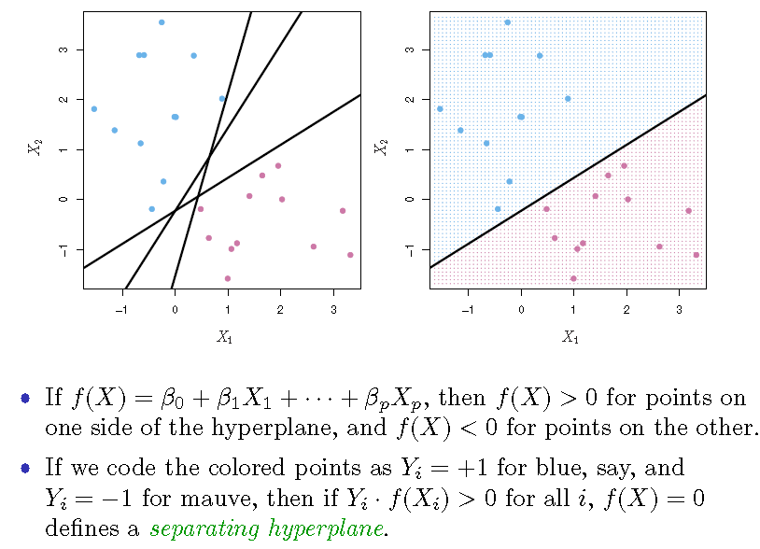
Separating Hyperplanes

Slide 10
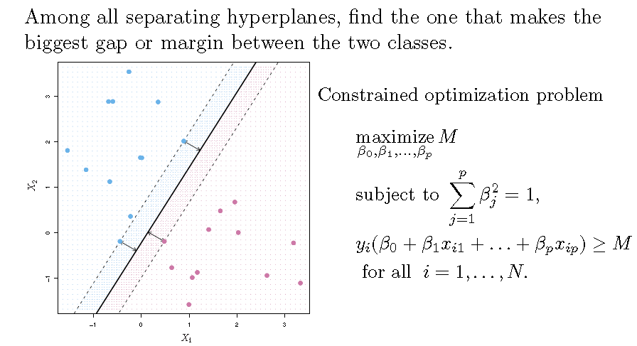
Maximal Margin Classier

Slide 11
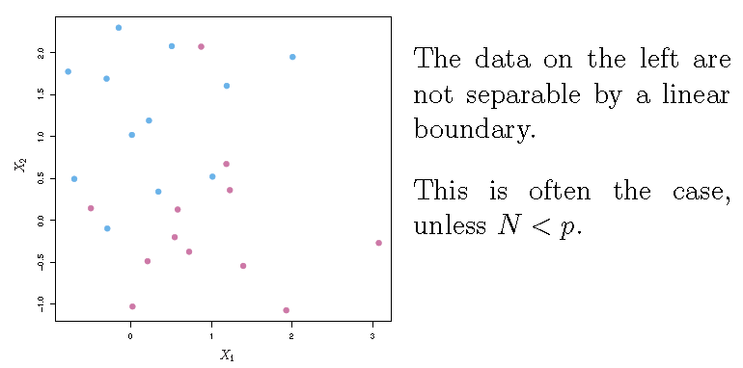
Non-Separable

Slide 12
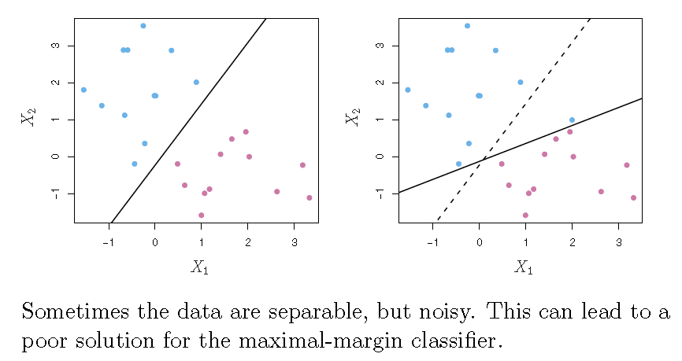
Noisy Data

Slide 13
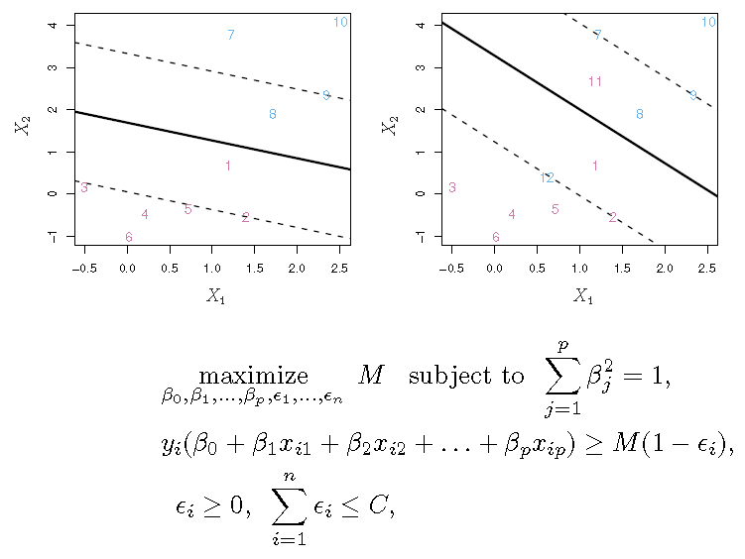
Support Vector Classifiers

Slide 14
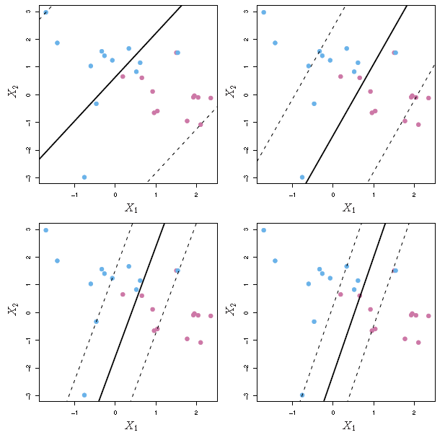
Regularization Paramater

Slide 15
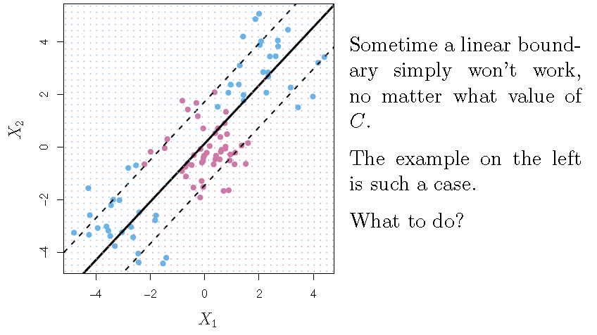
Linear Boundary May Fail!

Slide 16
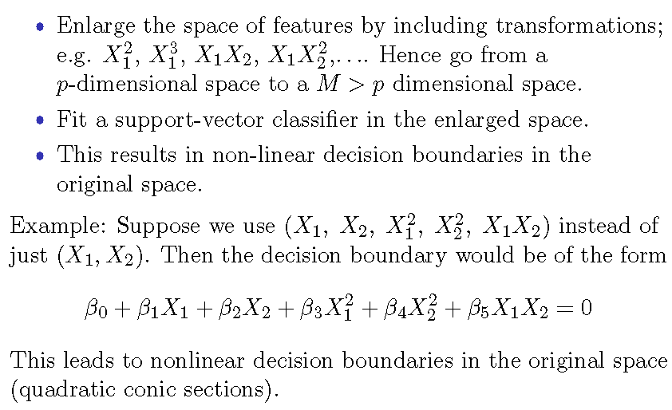
Feature Expansion

Slide 17
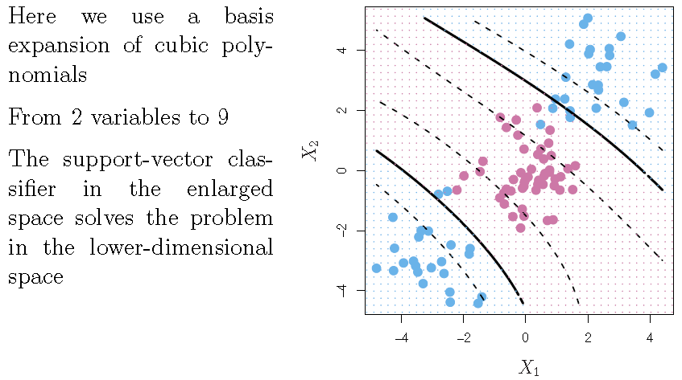
Cubic Polynomials

Slide 18
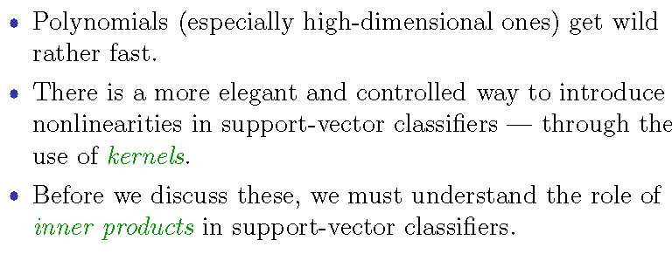
Non Linearities and Kernel

Slide 19
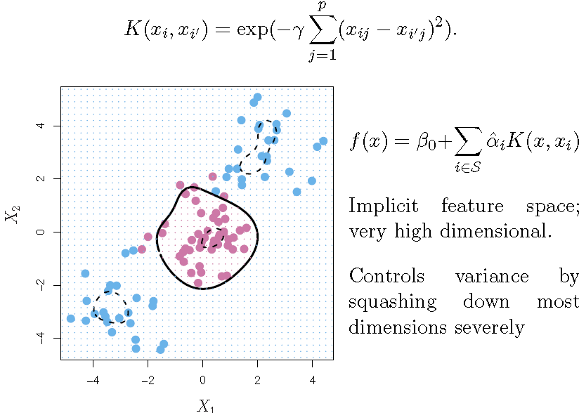
Radial Kernel

Slide 20
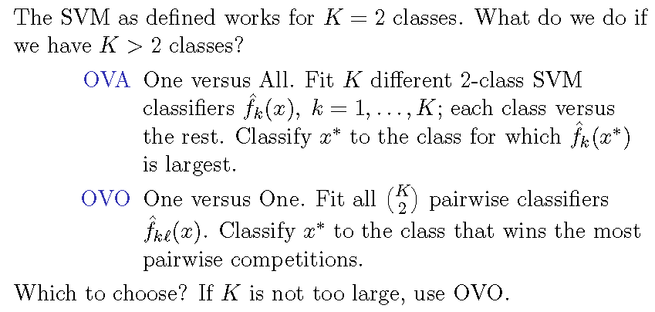
SVMs: more than 2 classes?

Slide 21
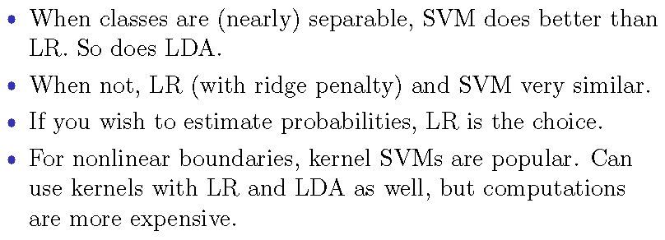
Which to use: SVM or Logistic Regression

Slide 22
Tugas 4: Kumpul 18 November 2015
Presentasi tugas besar
  Use case
  Class diagram
  R connection
  Demo

Slide 23
Laporan Akhir Semester
(kumpul di hari UAS 15 Desember 2015)
Pendahuluan
  Mengapa R
  Pemanfaatan R untuk aplikasi statistik
Landasan Teori
  Fungsi-fungsi dasar R untuk statistik
  Antarmuka R dengan bahasa pemrograman: RdotNet → symbolic expression (Marshal package???)
Perancangan
  Use case
  Class diagram / Sequence diagram
Hasil Implementasi
  Layout/Form (Manual Penggunaan)
  Pemanggilan R
Studi Kasus Pemanfaatan (Tugas: Individu)
  Data Summary and Analysis
  Linear Regression
  Classification: Logistic Regression, Decision Tree, SVM
  Dimensional Reduction: PCA

Slide 24
Practical Works: SVM
9.6.1 Support Vector Classifier
9.6.2 Support Vector Machine
9.6.5 Application to Gene Expression Data

