Slide 1
4 November 2015
Tree-Based Methods
Practical Quiz

Slide 2
Tree-based Methods
Here we describe tree-based methods for regression and classication.
These involve stratifying or segmenting the predictor space into a number of simple regions.
Since the set of splitting rules used to segment the predictor space can be summarized in a tree, these types of approaches are known as decision-tree methods.

Slide 3
Pros and Cons
Tree-based methods are simple and useful for interpretation.
However they typically are not competitive with the best supervised learning approaches in terms of prediction accuracy.
Hence we also discuss bagging, random forests, and boosting. These methods grow multiple trees which are then combined to yield a single consensus prediction.
Combining a large number of trees can often result in dramatic improvements in prediction accuracy, at the expense of some loss interpretation.

Slide 4
The Basic of Decision Tree
Decision trees can be applied to both regression and classication problems.
We first consider regression problems, and then move on to classication.

Slide 5
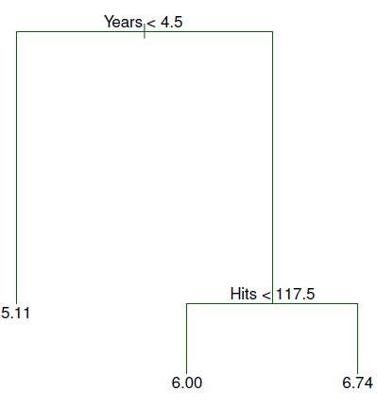
Baseball salary data: how would you stratify it?
Salary is color-coded from low (blue, green) to high (yellow,red)

Slide 6
The three-region partition for the Hitters data set

Slide 7
Tree Terminology
In keeping with the tree analogy, the regions R1, R2, and R3 are known as terminal nodes
Decision trees are typically drawn upside down, in the sense that the leaves are at the bottom of the tree.
The points along the tree where the predictor space is split are referred to as internal nodes
In the hitters tree, the two internal nodes are indicated by the text Years<4.5 and Hits<117.5.

Slide 8
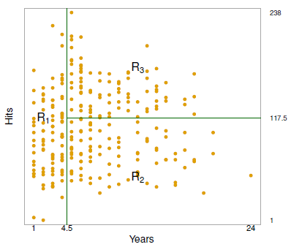
Interpretation

Slide 9
Details of the tree-building process

Slide 10
More details of the tree-building process

Slide 11
More details of the tree-building process

Slide 12
Details – Continued

Slide 13
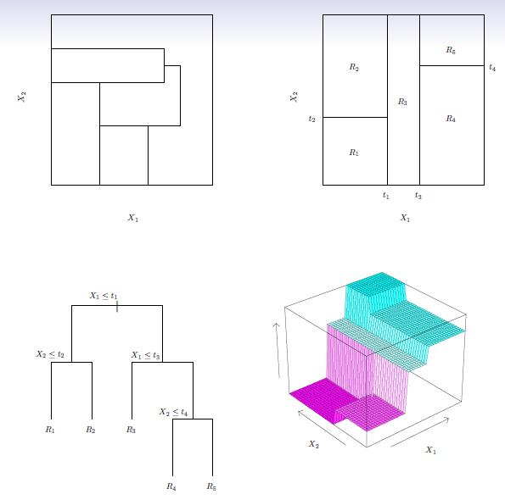
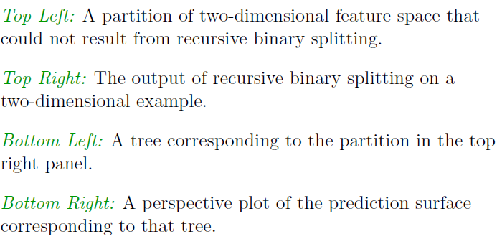
Predictions

Slide 14
Pruning a Tree

Slide 15
Pruning a tree – continued

Slide 16
Choosing the best subtree

Slide 17
Summary: tree algorithm

Slide 18
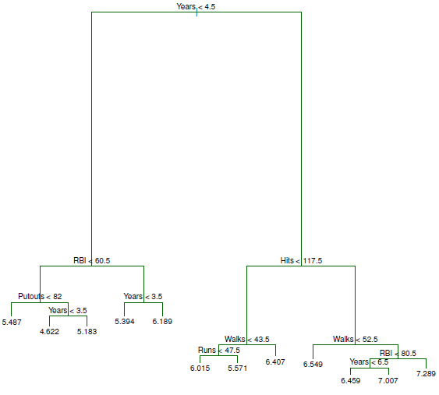
Baseball example continued

Slide 19
Baseball example continued

Slide 20
Classication Trees

Slide 21
Details of Classification Trees

Slide 22
Gini index and Deviance

Slide 23
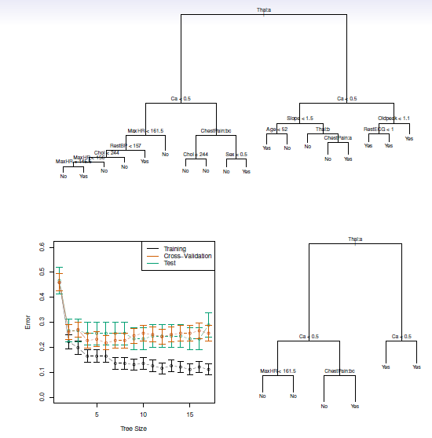
Example: heart data

Slide 24
Trees vs. Linear Model

Slide 25
Advantages and Disadvantages of Trees

Slide 26
Ensemble Methods
Construct a set of classifiers from the training data
Predict class label of previously unseen records by aggregating predictions made by multiple classifiers, usually voting mechanism

Slide 27
General Idea

Slide 28
Examples of Ensemble Methods
How to generate an ensemble of classifiers?
Bagging (using bootstrap sample)
Boosting (weight adjustment)
Random forest (special case of bagging; special design for decision tree classifiers)

Slide 29
Bagging

Slide 30
Bagging – continued

Slide 31
Bagging
Sampling with replacement
Build classifier on each bootstrap sample
Each sample has probability (1 – 1/n)^{n} of being selected
On avarage, a bootstrap sample contains approximately 63% of the original training data

Slide 32
Boosting

Slide 33
Boosting Algorithm for Regression Trees

Slide 34
What is the idea behind this procedure?

Slide 35
Boosting
An iterative procedure to adaptively change distribution of training data by focusing more on previously misclassified records
Initially, all N records are assigned equal weights
Unlike bagging, weights may change at the end of boosting round

Slide 36
Boosting
Records that are wrongly classified will have their weights increased
Records that are classified correctly will have their weights decreased
Example 4 is hard to classify
Its weight is increased, therefore it is more likely to be chosen again in subsequent rounds

Slide 37
Boosting for Classification

Slide 38
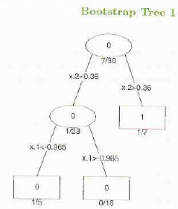
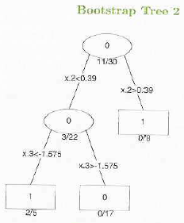
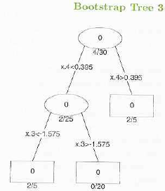

Slide 39
Random Forest

Slide 40
Random Forest

Slide 41
Practical Works
8.3.1 Fitting Classification Trees
8.3.2 Fitting Regression Trees
8.3.3 Bagging and Random Forests
8.3.4 Boosting

Slide 42
Practical Quiz
Model Selection (Boston dataset in MASS package)
Chapter 6 Exercise 11
GAM (Wage dataset in ISLR package)
Explore the lab example in Chapter 7.8.3
Explain what you have done

Slide 43
Tugas 4: Kumpul 18 November 2015
Presentasi tugas besar
Use case
Class diagram
R connection
Demo

