Slide 1
Ch. 5.1-5.5: Indexing (1)
Information Retrieval in Practice
All slides ©Addison Wesley, 2008

Slide 2
Indexes
Indexes are data structures designed to make search faster
Text search has unique requirements, which leads to unique data structures
Most common data structure is inverted index
general name for a class of structures
“inverted” because documents are associated with words, rather than words with documents
similar to a concordance

Slide 3
Indexes and Ranking
Indexes are designed to support search
faster response time, supports updates
Text search engines use a particular form of search: ranking
documents are retrieved in sorted order according to a score computing using the document representation, the query, and a ranking algorithm
What is a reasonable abstract model for ranking?
enables discussion of indexes without details of retrieval model

Slide 4
Abstract Model of Ranking

Slide 5
More Concrete Model

Slide 6
Inverted Index
Each index term is associated with an inverted list
Contains lists of documents, or lists of word occurrences in documents, and other information
Each entry is called a posting
The part of the posting that refers to a specific document or location is called a pointer
Each document in the collection is given a unique number
Lists are usually document-ordered (sorted by document number)

Slide 7
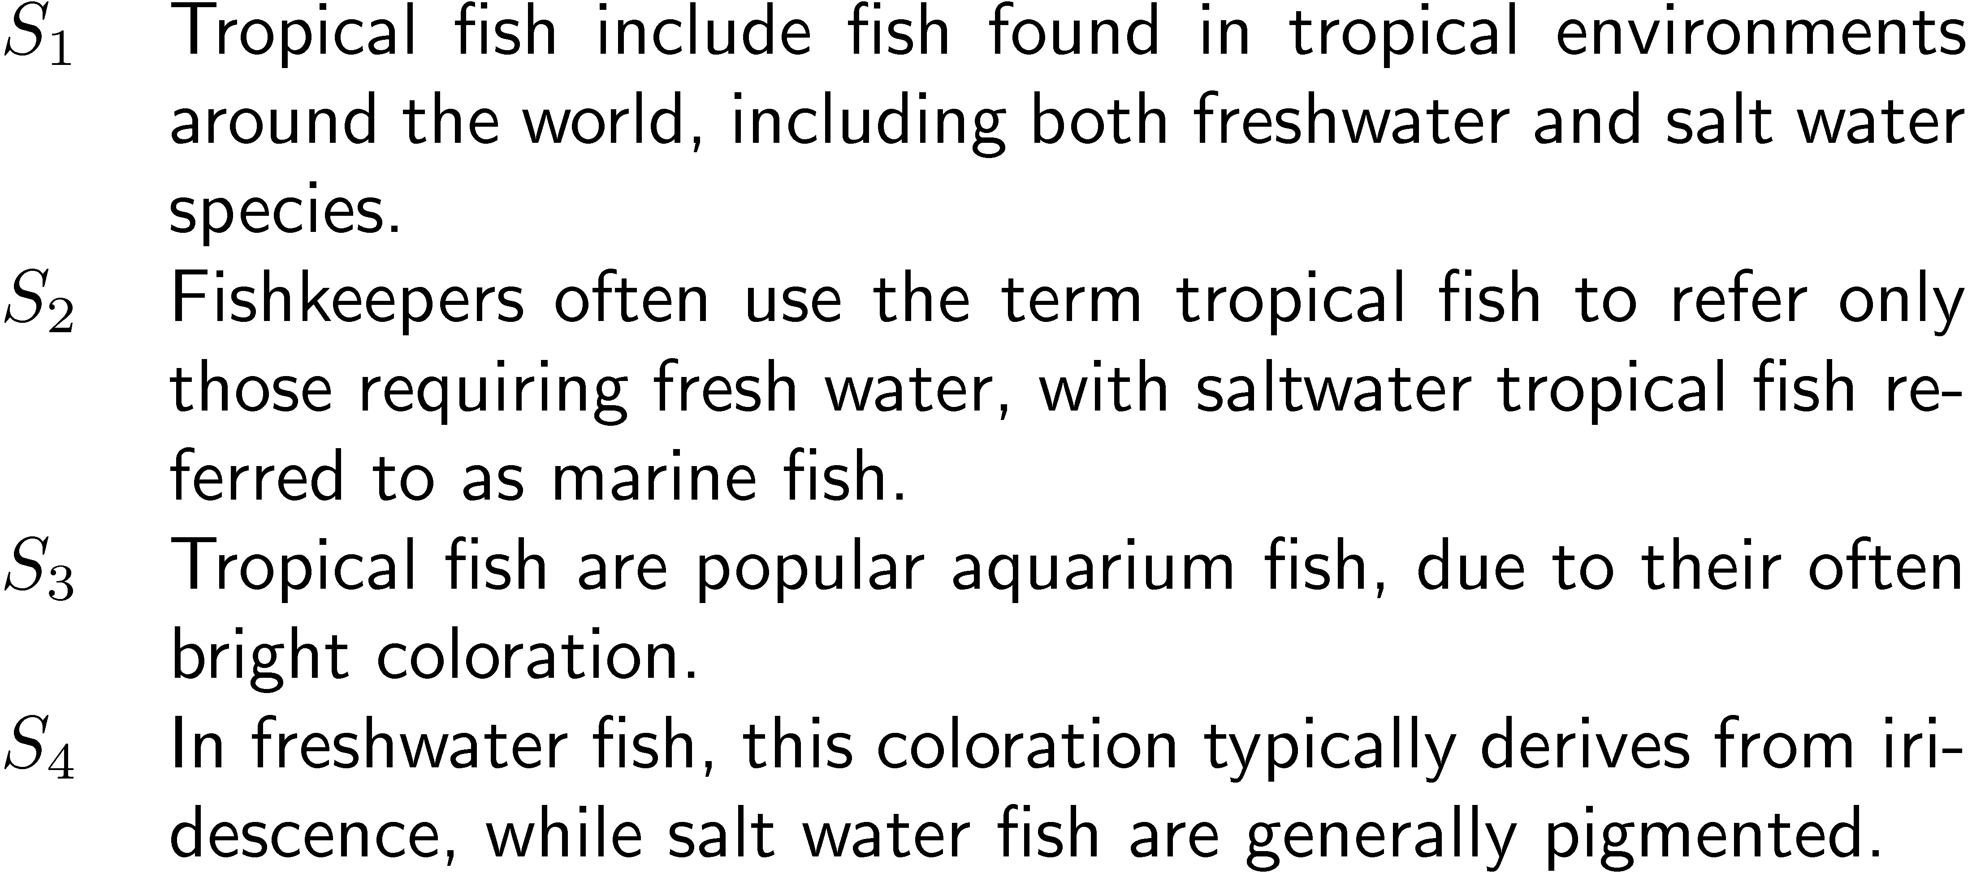
Example “Collection”

Slide 8
Simple Inverted Index

Slide 9
Inverted Index
with counts
supports better ranking algorithms

Slide 10
Inverted Index
with positions
supports
proximity matches

Slide 11
Proximity Matches
Matching phrases or words within a window
e.g., "tropical fish", or “find tropical within 5 words of fish”
Word positions in inverted lists make these types of query features efficient
e.g.,

Slide 12
Fields and Extents
Document structure is useful in search
field restrictions
e.g., date, from:, etc.
some fields more important
e.g., title
Options:
separate inverted lists for each field type
add information about fields to postings
use extent lists

Slide 13
Extent Lists
An extent is a contiguous region of a document
represent extents using word positions
inverted list records all extents for a given field type
e.g.,
extent list

Slide 14
Other Issues
Precomputed scores in inverted list
e.g., list for “fish” [(1:3.6), (3:2.2)], where 3.6 is total feature value for document 1
improves speed but reduces flexibility
Score-ordered lists
query processing engine can focus only on the top part of each inverted list, where the highest-scoring documents are recorded
very efficient for single-word queries

Slide 15
Compression
Inverted lists are very large
e.g., 25-50% of collection for TREC collections using Indri search engine
Much higher if n-grams are indexed
Compression of indexes saves disk and/or memory space
Typically have to decompress lists to use them
Best compression techniques have good compression ratios and are easy to decompress
Lossless compression – no information lost

Slide 16
Compression
Basic idea: Common data elements use short codes while uncommon data elements use longer codes
Example: coding numbers
number sequence:
possible encoding:
encode 0 using a single 0:
only 10 bits, but...

Slide 17
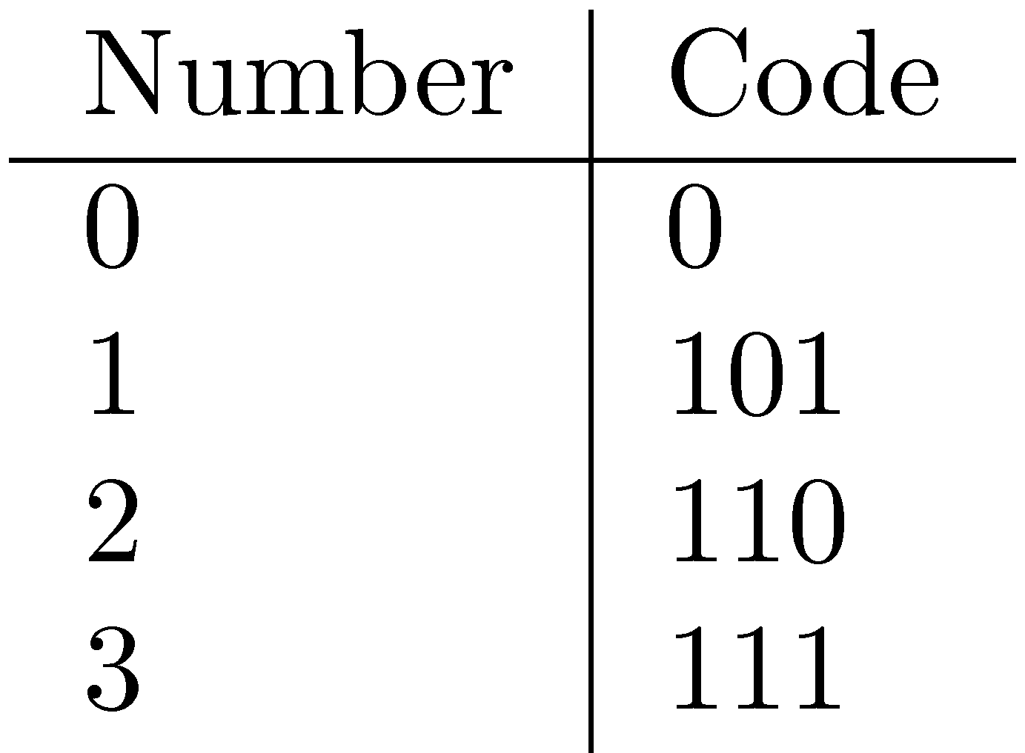
Compression Example
Ambiguous encoding – not clear how to decode
another decoding:
which represents:
use unambiguous code:
which gives:

Slide 18
Delta Encoding
Word count data is good candidate for compression
many small numbers and few larger numbers
encode small numbers with small codes
Document numbers are less predictable
but differences between numbers in an ordered list are smaller and more predictable
Delta encoding:
encoding differences between document numbers (d-gaps)

Slide 19
Delta Encoding
Inverted list (without counts)
Differences between adjacent numbers
Differences for a high-frequency word are easier to compress, e.g.,
Differences for a low-frequency word are large, e.g.,

Slide 20
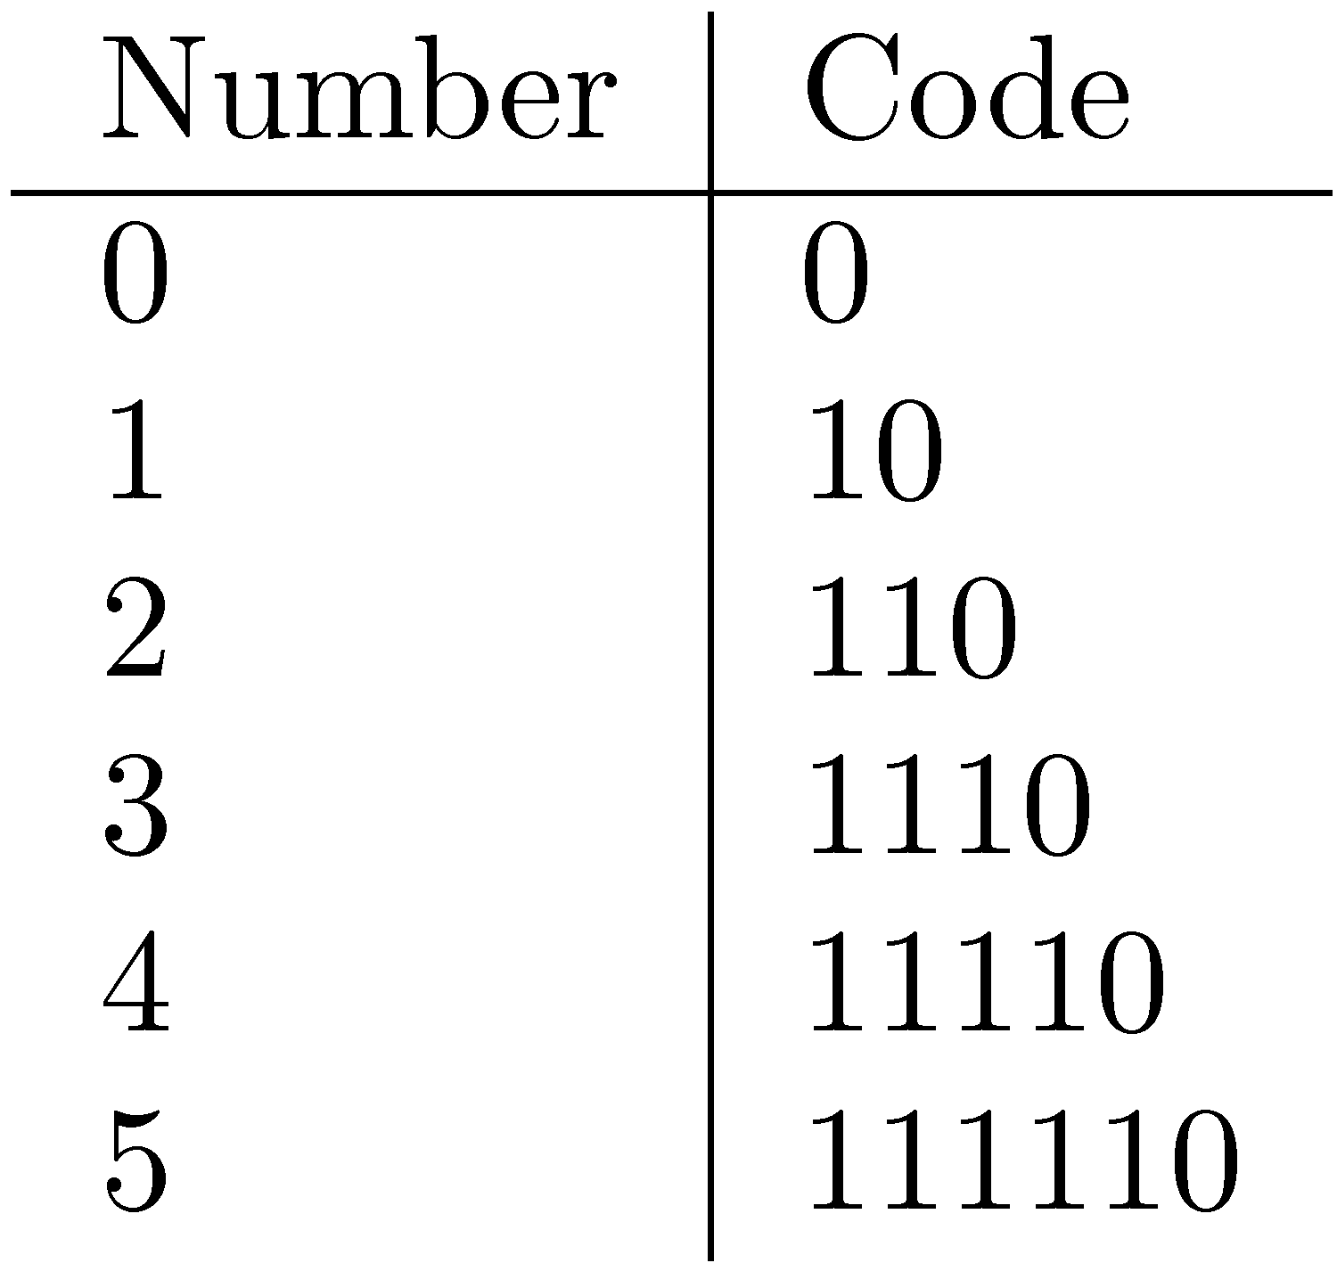
Bit-Aligned Codes
Breaks between encoded numbers can occur after any bit position
Unary code
Encode k by k 1’s followed by 0
0 at end makes code unambiguous

Slide 21
Unary and Binary Codes
Unary is very efficient for small numbers such as 0 and 1, but quickly becomes very expensive
1023 can be represented in 10 binary bits, but requires 1024 bits in unary
Binary is more efficient for large numbers, but it may be ambiguous

Slide 22
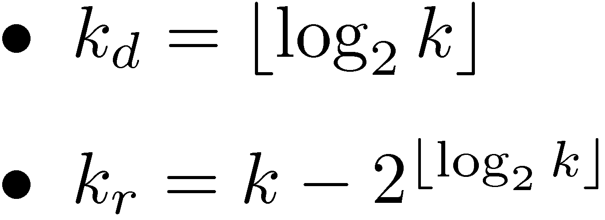
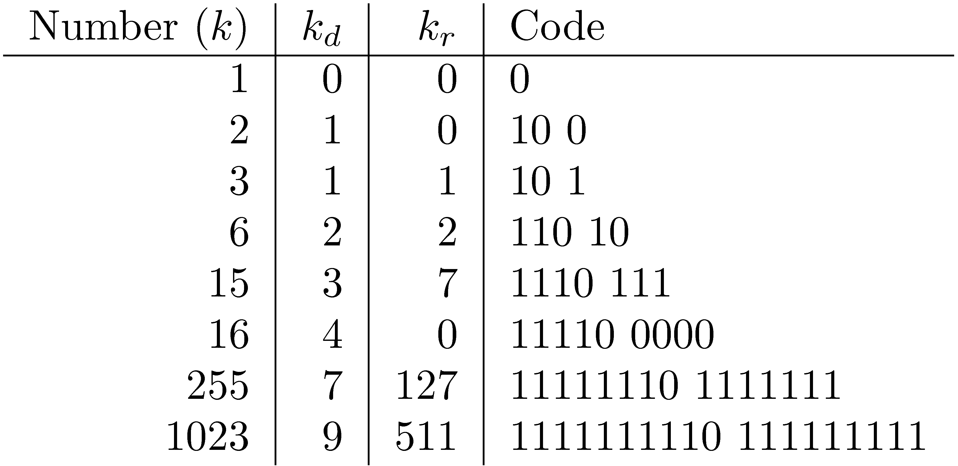
Elias-γ Code
To encode a number k, compute
k_{d} is number of binary digits, encoded in unary
The unary part of the code tells us:
How many bits to expect in the binary part.

Slide 23
Elias-δ Code
Elias-γ code uses no more bits than unary, many fewer for k > 2
1023 takes 19 bits instead of 1024 bits using unary
In general, takes 2⌊log₂k⌋+1 bits
To improve coding of large numbers, use Elias-δ code
Instead of encoding k_{d} in unary, we encode k_{d} + 1 using Elias-γ
Takes approximately 2 log₂ log₂ k + log₂ k bits

Slide 24
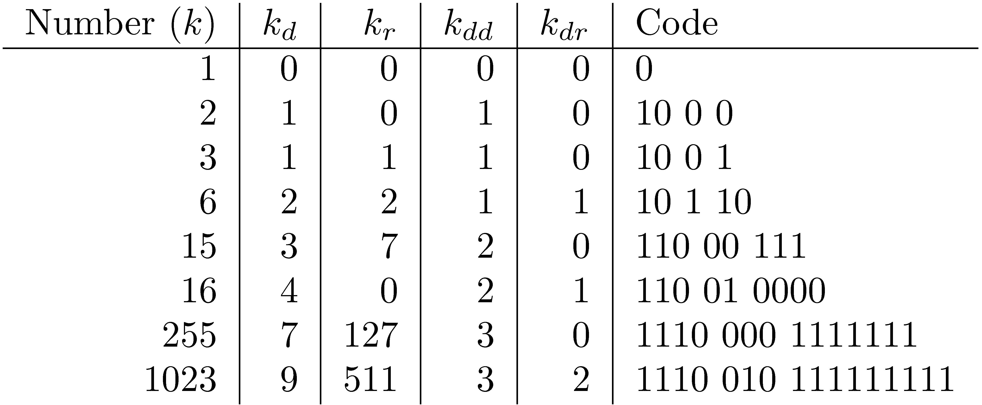
Elias-δ Code
Elias-γ Code
Split k_{d} into:
encode k_{dd} in unary, k_{dr} in binary, and k_{r} in binary
(k_{d+}1)

Slide 26
Byte-Aligned Codes
Variable-length bit encodings can be a problem on processors that process bytes
v-byte is a popular byte-aligned code
Similar to Unicode UTF-8
Shortest v-byte code is 1 byte
Numbers are 1 to 4 bytes, with high bit 1 in the last byte, 0 otherwise

Slide 27
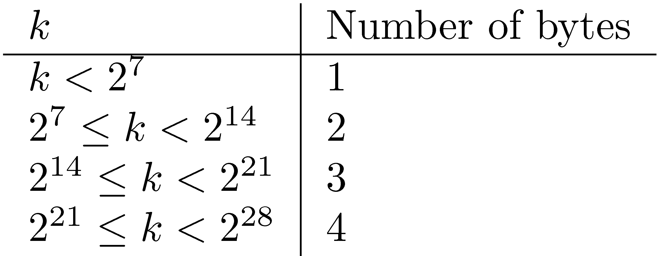
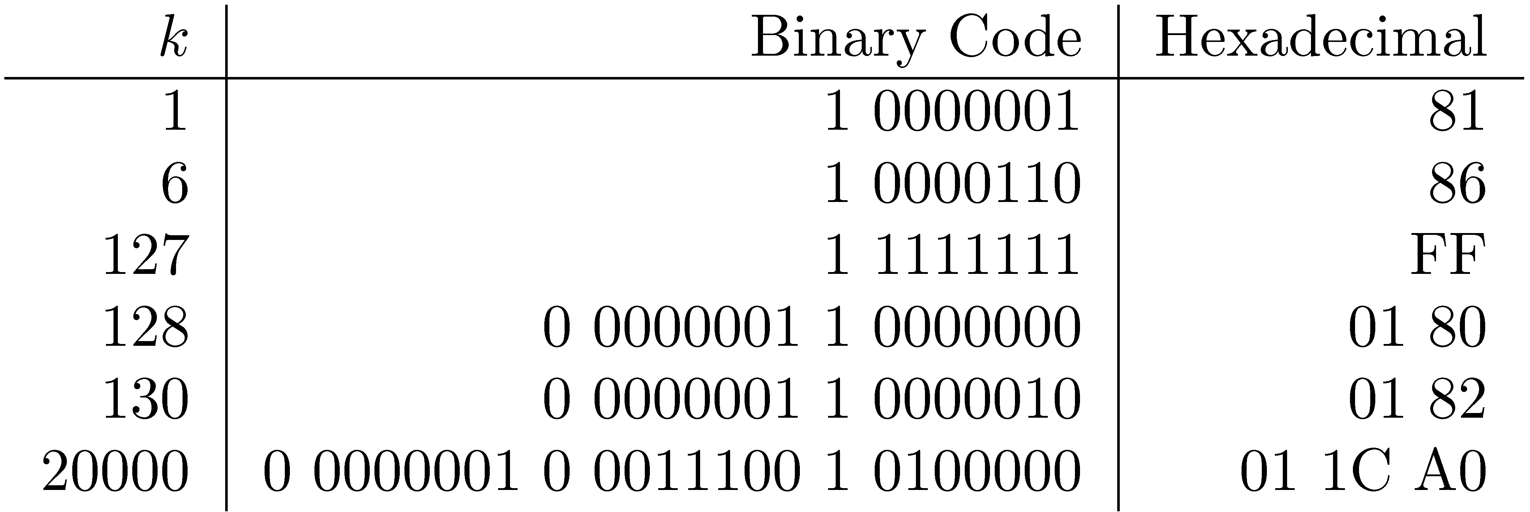
V-Byte Encoding

Slide 28
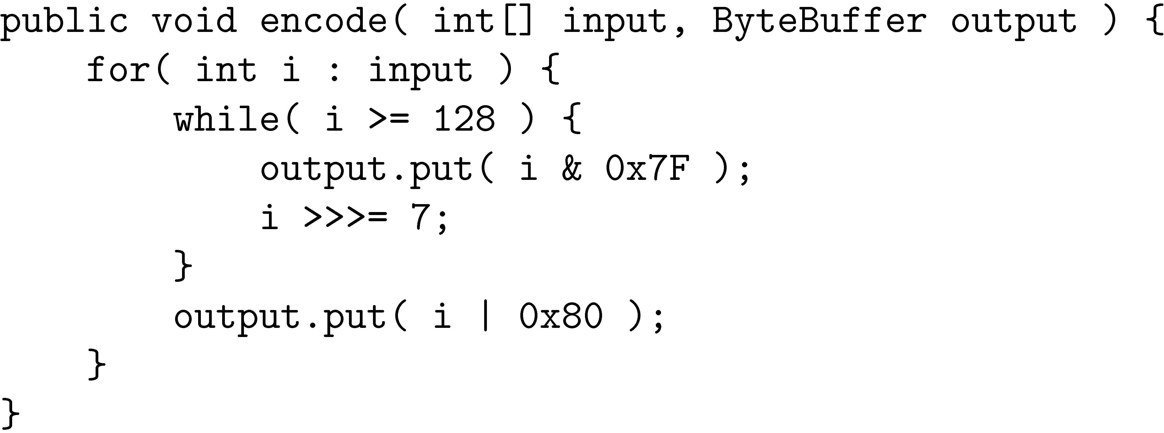
V-Byte Encoder

Slide 29
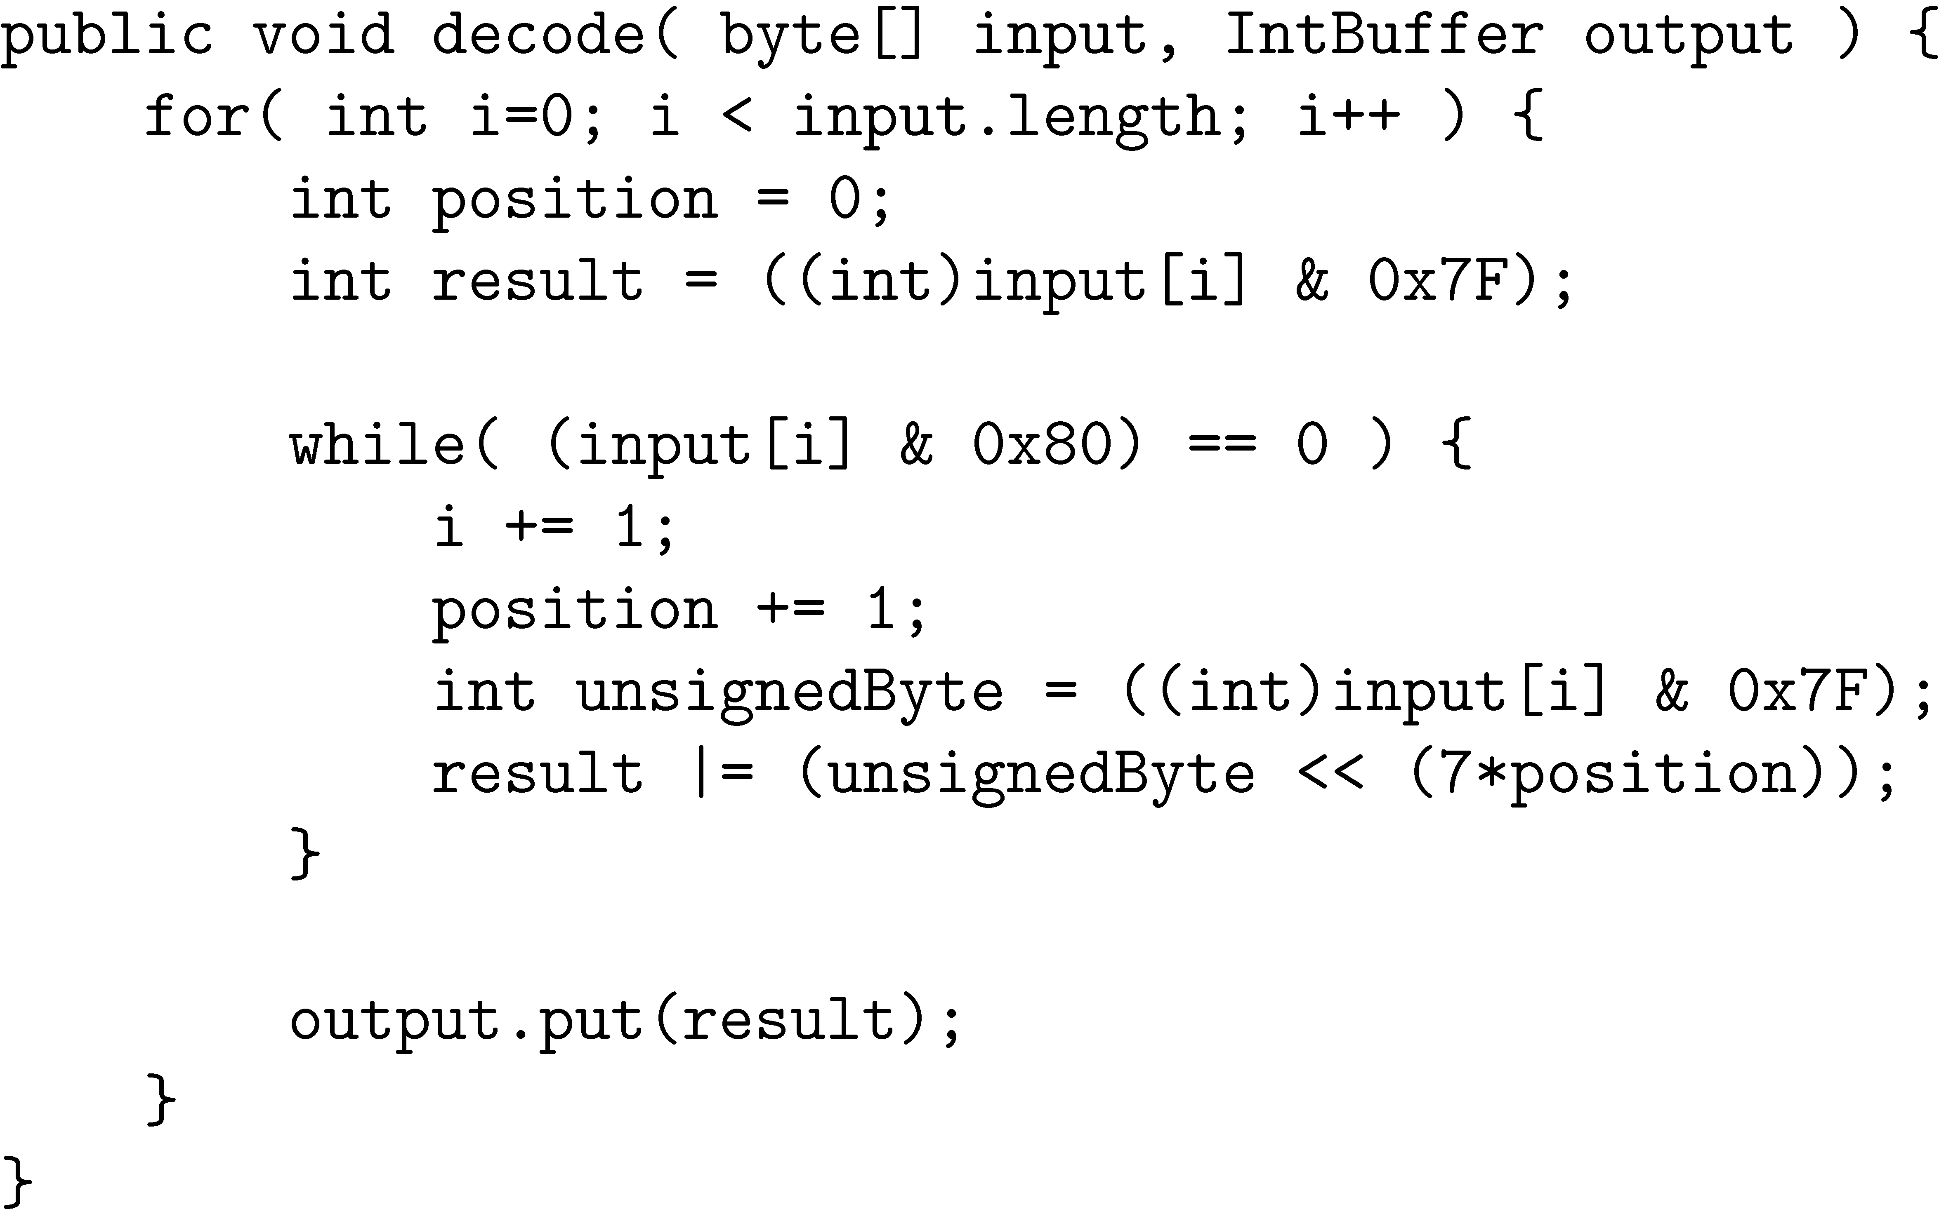
V-Byte Decoder

Slide 30
Compression Example
Consider invert list with positions:
Delta encode document numbers and positions:
Compress using v-byte:

Slide 31
Skipping
Search involves comparison of inverted lists of different lengths
Can be very inefficient
“Skipping” ahead to check document numbers is much better
Compression makes this difficult
Variable size, only d-gaps stored
Skip pointers are additional data structure to support skipping

Slide 32
Skip Pointers
A skip pointer (d, p) contains a document number d and a byte (or bit) position p
Means there is an inverted list posting that starts at position p, and the posting before it was for document d
Inverted list
skip pointers

Slide 33
Skip Pointers
Example
Inverted list
D-gaps
Skip pointers (3 skips)

Slide 34
Auxiliary Structures
Inverted lists usually stored together in a single file for efficiency
Inverted file
Vocabulary or lexicon
Contains a lookup table from index terms to the byte offset of the inverted list in the inverted file
Either hash table in memory or B-tree for larger vocabularies
Term statistics stored at start of inverted lists
Collection statistics stored in separate file

Slide 35
Kuis 2 (nrp-nama.docx)
Apakah yang dimaksud dengan Zipf’s Law dan mengapa ini penting dalam bidang temu balik?
Berikan penjelasan singkat mengenai:
Tokenizing
Stemming
POS-tag
N-gram

Slide 36
Kuis 2
Gunakan tools berikut ini:
http://text-processing.com/demo/tokenize/
http://text-processing.com/demo/stem/
Low gas prices have meant healthy sales of trucks and S.U.V.s, but automakers are looking ahead to stricter fuel economy rules by showcasing electric and hybrid models.
Pilihlah hasil terbaik menurut Anda, dan berikan alasan:
Tokenizing:
TreebankWordTokenizer
WordPunctTokenizer
PunctWordTokenizer
WhitespaceTokenizer
Stemming:
Porter stemmer
Lancaster stemmer

Slide 37
Tugas 1 & 2: Kelompok Praktikum (SP)
Lakukan instalasi Solr
Pastikan bahwa Solr dapat melakukan temu balik sederhana sesuai dengan contoh dalam Reference Guide. Buat laporan singkat (2-3 hal.) dan/atau contoh kode serta hasilnya mengenai:
Arsitektur Solr
Cara melakukan indexing Solr
Cara melakukan temu balik sederhana Solr
Pengumpulan: s.d. Rabu, 13 Januari 2016

Slide 38
Tugas 3&4: Kelompok Praktikum (SP)
Anda diminta untuk mengumpulkan 80 file teks berita dengan dua kategori utama (40 berita untuk setiap kategori).
Kategori berita setiap kelompok tidak boleh sama dan berita harus dituliskan dalam bahasa Inggris.
Alternatif kategori:
Hitung document statistics sbb (Java is code prefer):
a) Arts
b) Business
c) Entertainment
d) Fashion
e) Medicine
f) Politics
g) Education
h) Sports
i) Technology
j) Nature
k) Music
l) Science
Total documents
Total word occurrences
Vocabulary size
Words occurring > 1000 times
Words occurring once
Pengumpulan: Senin, 18 Januari 2016

